Slide 1
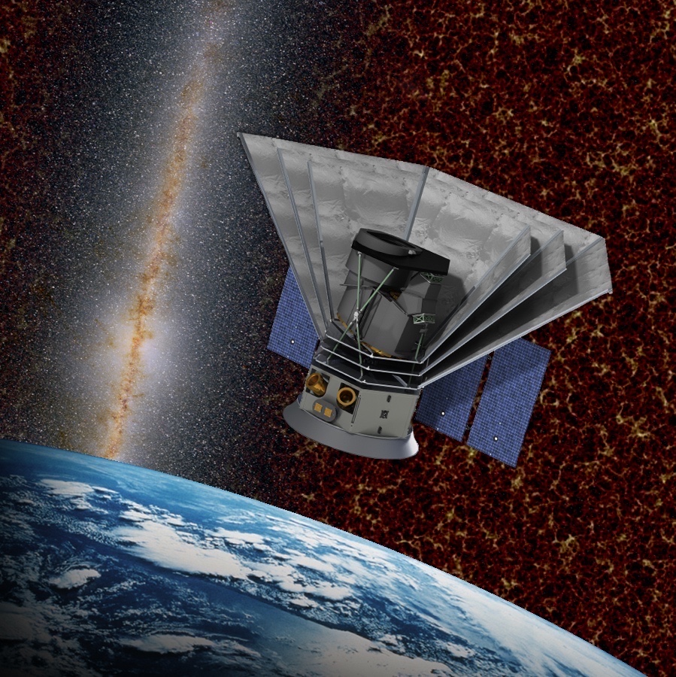
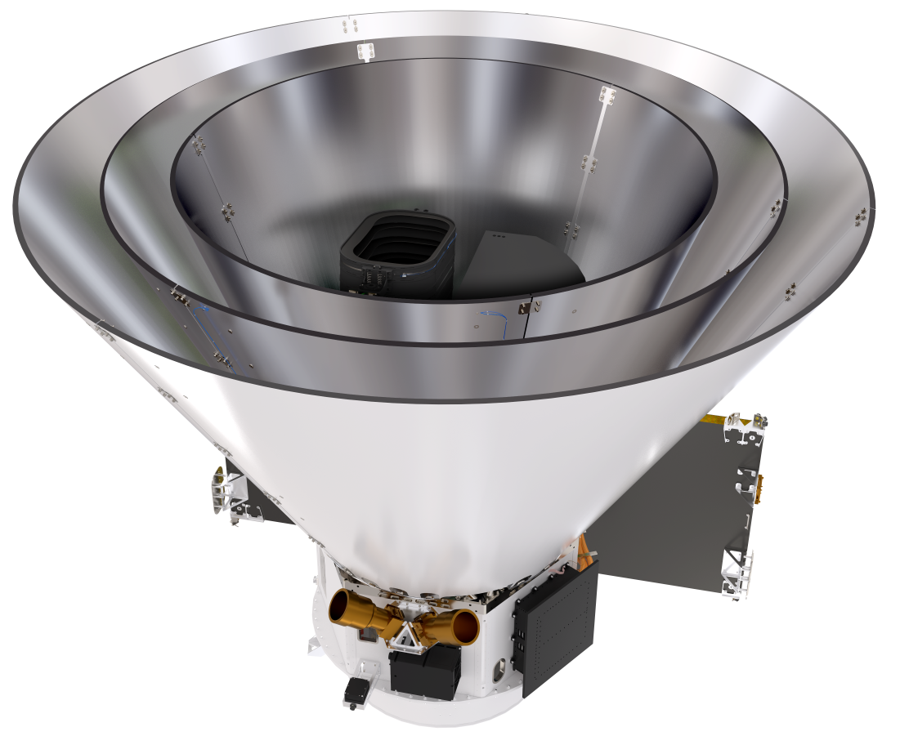









SPHERE^{x}
Rachel Akeson
SPHEREx Science Data Center Lead
Caltech/IPAC

Slide 2
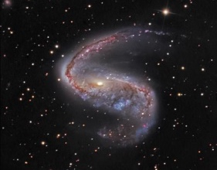
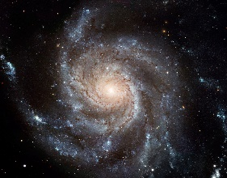
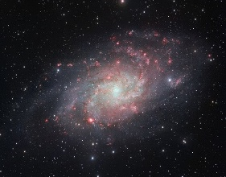
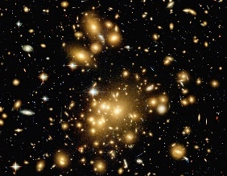
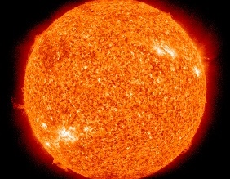
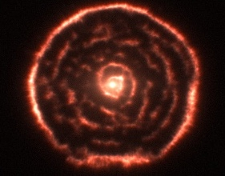
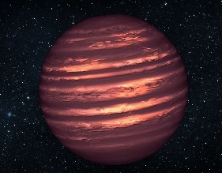
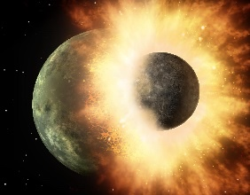
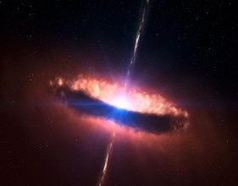
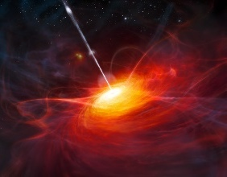
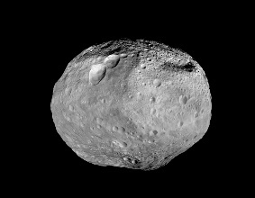
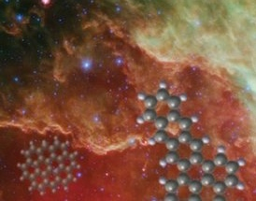
Contents
Medium-
Accuracy
Spectra
> 100 million
High-
Accuracy
Spectra
10 million
SPHEREx Overview and Launch
Data Products and Tools
Stellar and Brown Dwarf Catalog
Detected
> 1 billion
Clusters
25,000
Galaxies
Main
Sequence Spectra
> 100 million
Brown
Dwarfs
> 400
Dust-forming
10,000
Cataclysms
> 1,000
Stars
Asteroid
& Comet
Spectra
10,000
Galactic
Line Maps
PAH, HI, H₂
Quasars
> 1.5 million
Quasars z >7
2 – 300?
Other

Slide 3
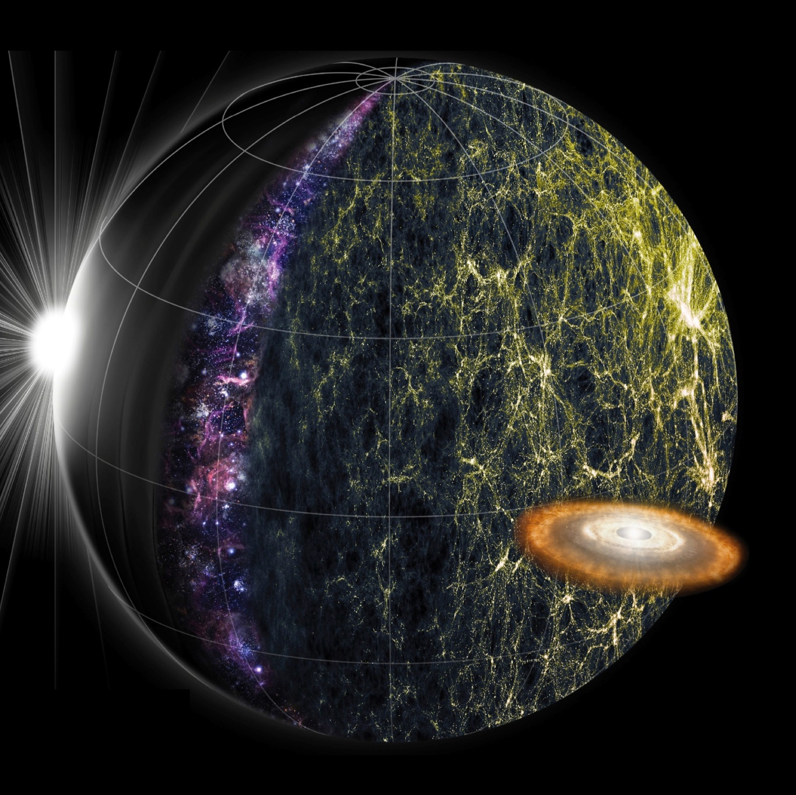
SPHEREX IS DESIGNED TO ADDRESS THE MOST
IMPORTANT QUESTIONS IN ASTROPHYSICS
A NASA MIDEX Astrophysics mission selected on Feb. 19 2019
  Same mission class as Swift, WMAP, WISE, TESS, and UVEX
Investigating Three Fundamental Questions
What are the Conditions for Life Outside the Solar System?
  Survey the Milky Way for water ices and other biogenic molecules
How did Galaxies begin?
  Study the cosmic history of light production through near-infrared background fluctuations
How did the Universe begin?
  Probe the physics of the young inflationary Universe through the 3D spatial distribution of galaxies

Slide 4
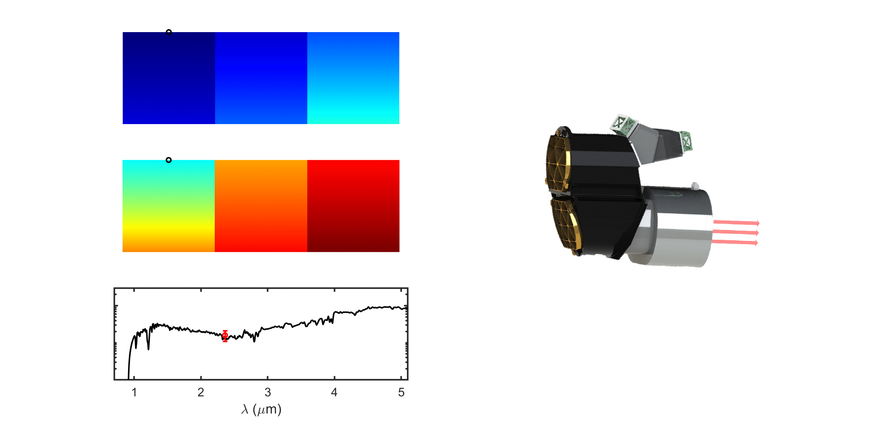
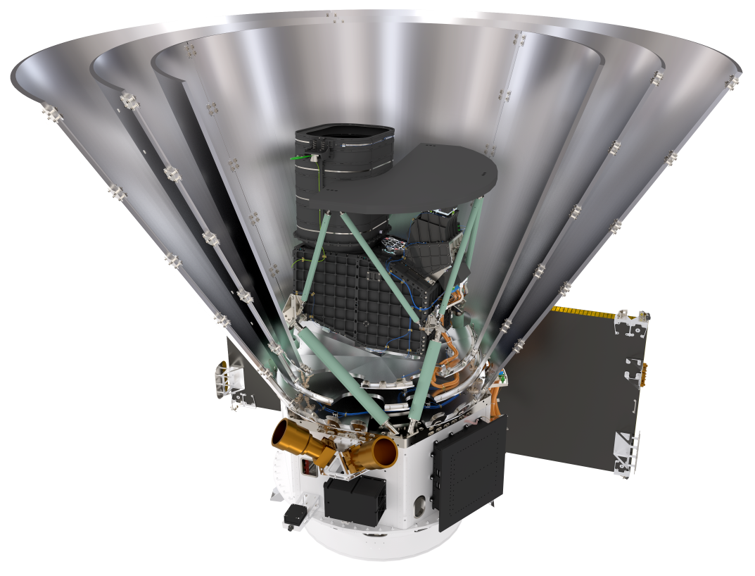
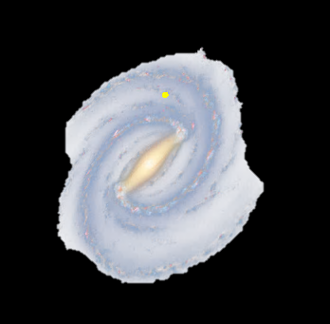
SPHERE^{x} IN A NUTSHELL
Reflected by Dichroic
Photon shields
(shown cutaway)
λ/Δλ = 41 41 41
Detectors and
LVF spectrometers
Transmitted by Dichroic
2.0 m
20 cm wide-field telescope
λ = 0.75 – 5 μm
λ/Δλ = 35 – 130
6.2″ pixels
λ/Δλ = 35 110 130
Passive cooling system
T_{scope} < 80 K
T_{FPU} < 55 K
LEO spacecraft
(BAE Systems)
Pointing modulates the wavelength of observation
A complete spectrum in 51 exposures
Each exposure takes 115s
1 complete spectrum every 6 months

Slide 5
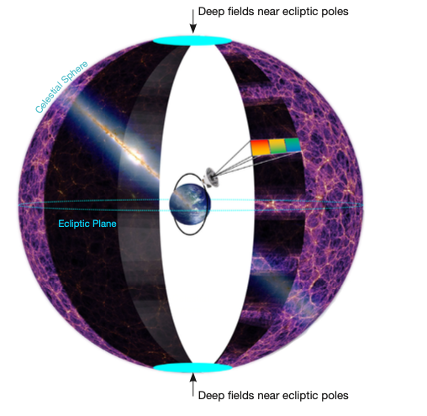
Survey strategy: Whole sky plus deep fields
SPHEREx will survey the whole sky every 6 months
4 visits for every point on sky during prime mission
North and south deep fields will have up to 400 visits each

Slide 6
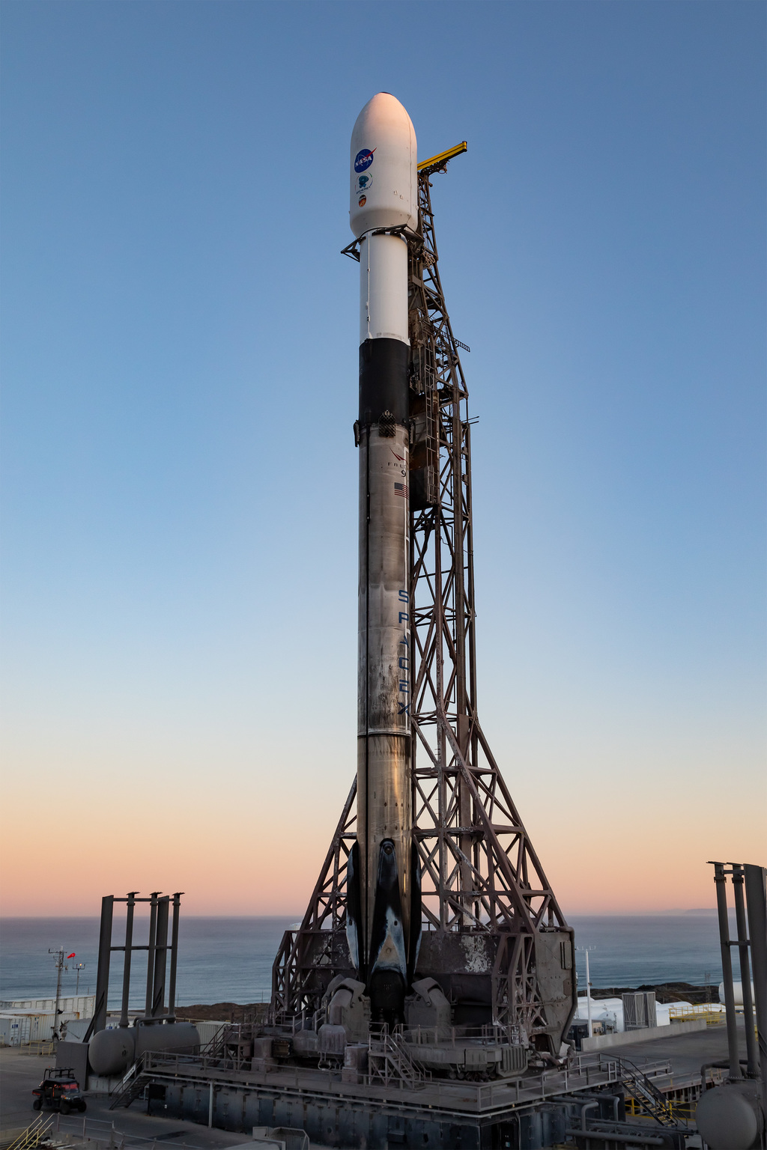
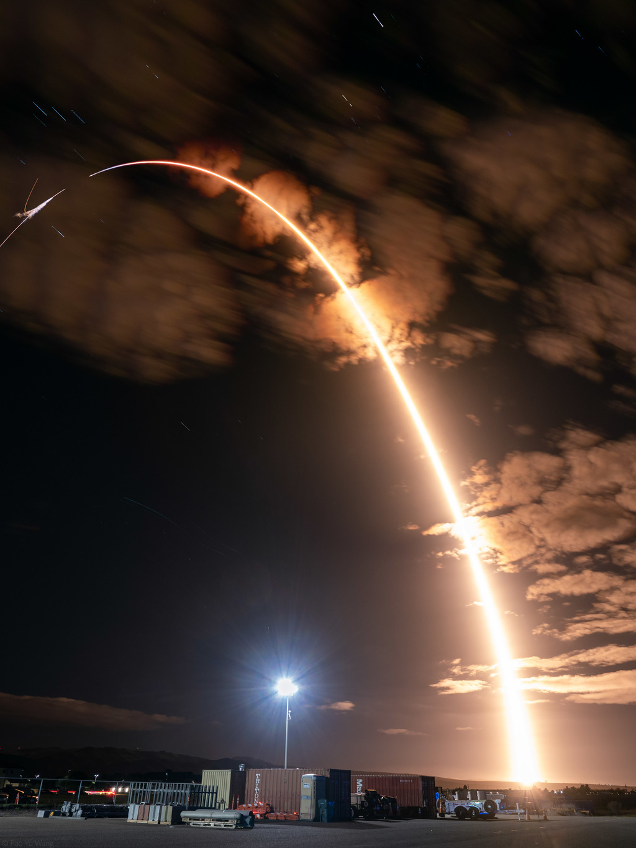
SPHEREx Launched on March 11, 2025
Credit:Space X

Slide 7
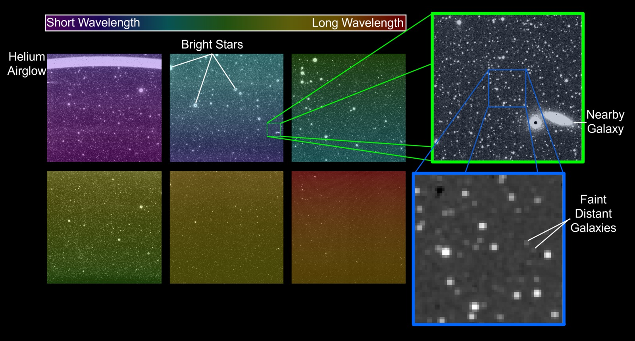
Followed by first light on March 27

Slide 8
Science Survey started on May 1
Instrument performance meets or exceeds requirements

Slide 9
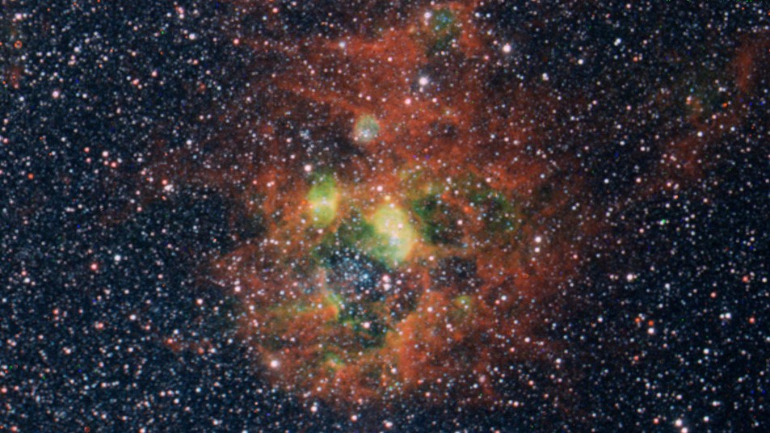
Example line detection
Three color mosaic of SPHEREx images from channels centered at 0.98 um (blue), 0.96 um (green) and 3.29 um (red). The green areas show ionization regions near a cluster of young stars in blue, traced out in the doubly ionized sulfur line, while red traces emission from the surrounding dusty PAHs.
See other examples at spherex.caltech.edu

Slide 10
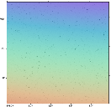
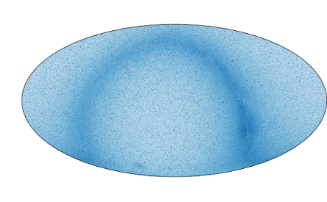
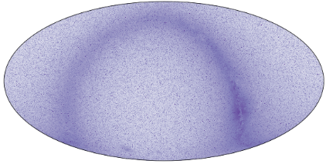
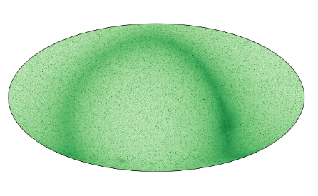
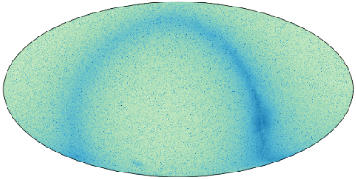
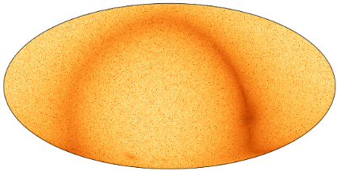

SPHEREx Data at IRSA
SPHEREx public data will be hosted at the NASA/IPAC Infrared Science Archive (IRSA)
Standard IRSA capabilities
  Includes search, visualization and download capabilities
  Web-based and application programming interfaces (APIs)
SPHEREx data products will use community data access and metadata standards
Custom Tools
  Spectrophotometry (uses same method as pipeline)
  LVF Image Cutout
  Source Discovery
  Custom Mosaic
  Spectral Cube Cutout
Data Products
Calibrated Spectral Image Data
  Output of Pipeline Level 2
  Available in archive within 60 days
102 All-sky Data Cubes
  Part of Year 1 and 2 Data Release
High Reliability Source Catalog
  Photometry measurements at native wavelengths and binned over 102 spectral channels
  Sources selected from input catalog
  Created after 3 sky surveys
Legacy Data Products
  Released at end of mission
  Legacy Deep Field Mosaics
  Legacy Galaxy Catalog
  Legacy Stellar Type/Ice Column Density Catalog
  Stellar, Galaxy Cluster and Solar System Catalogs

Slide 11
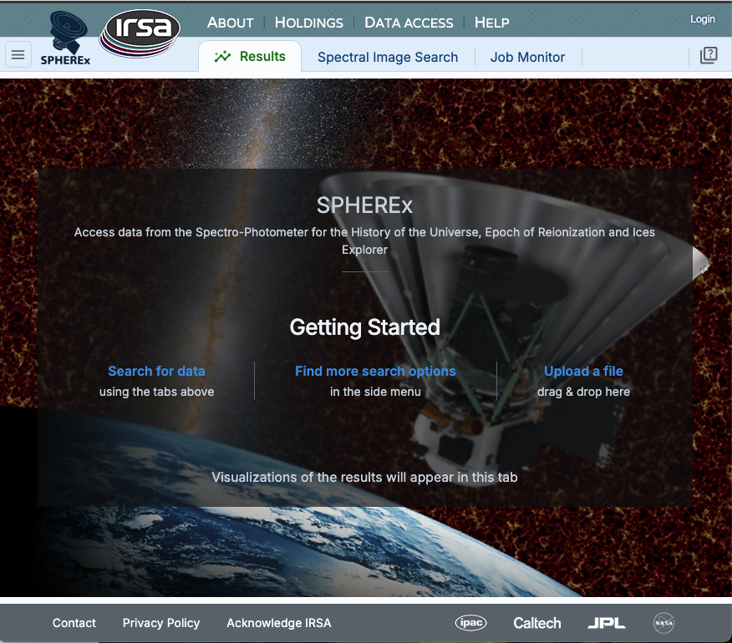
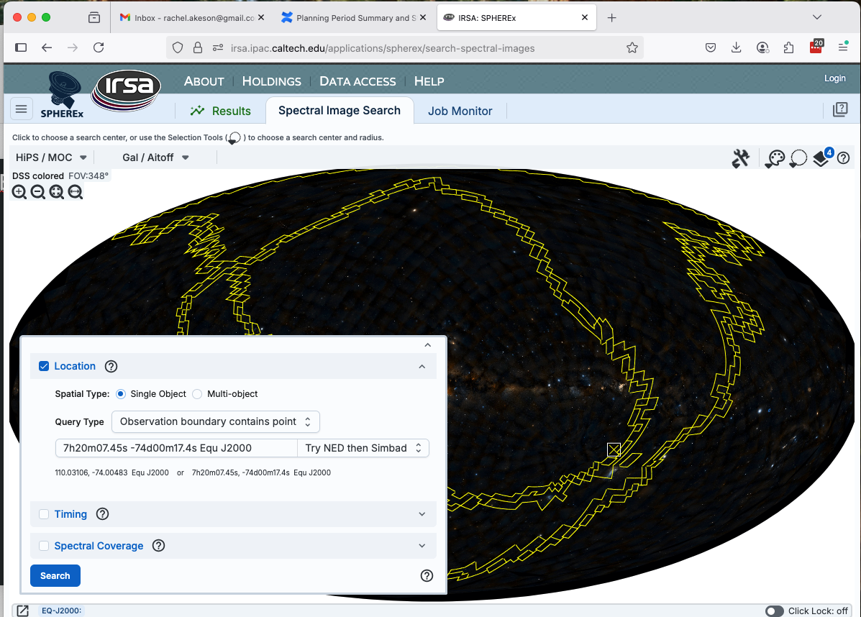
Image Search interface

Slide 12
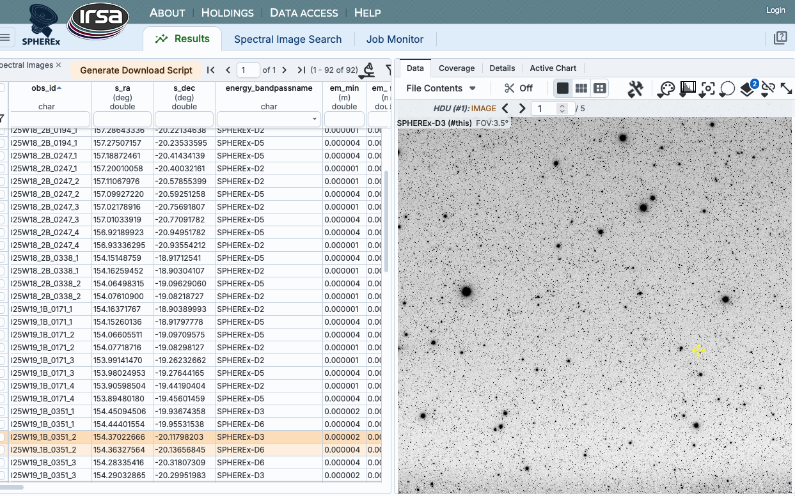
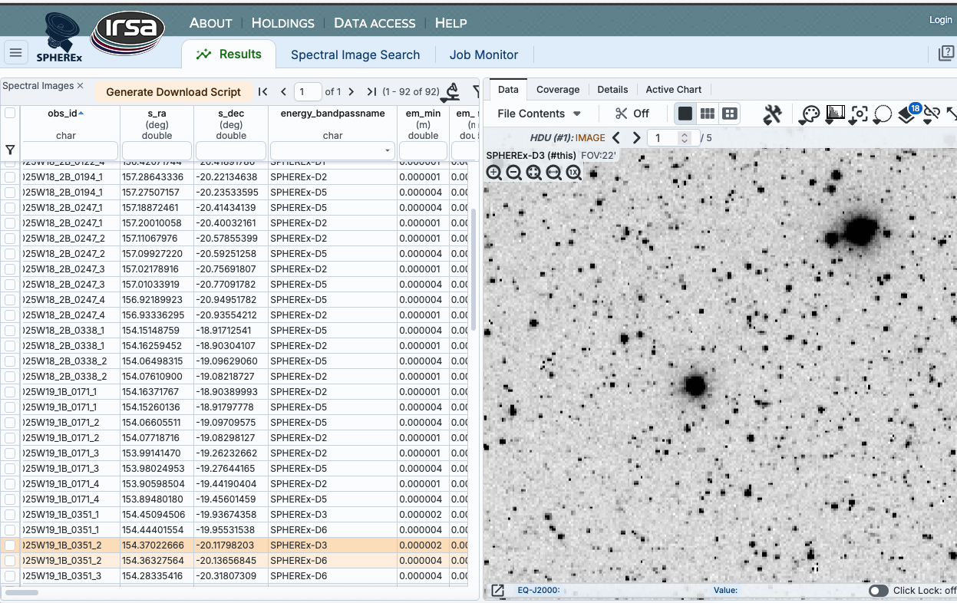
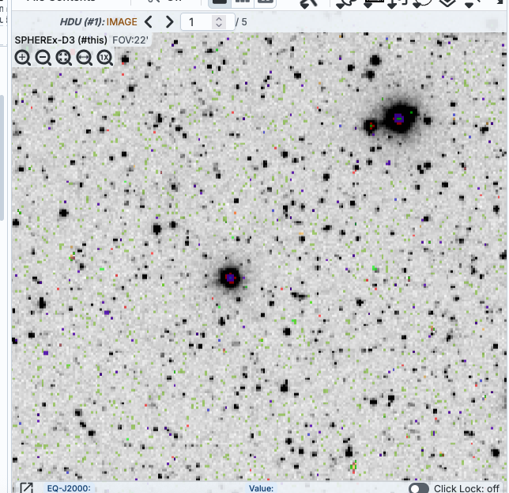
Calibrated Image Results

Slide 13
Other products and TOOLs
Calibration products
  Absolute gain
  PSF (also in Level 2 images
  Dark
  Read noise
  Spectral WCS (per pixel wavelength and bandwidth for each detector)
  Nonfunctional and dichroic impacted pixels
Bulk Downloads
  On premises at IPAC and in AWS cloud
APIs
  Astroquery and pyvo
  SIA (Simple Image Access) queries
Notebook
  https://caltech-ipac.github.io/irsa-tutorials/tutorials/spherex/spherex_intro.html
  Functionality
    Query for SPHEREx Spectral Image Multi-Extension FITS files (MEFs) that overlap a given coordinate on the sky.
    Read in a SPHEREx Spectral Image MEF using Astropy and understand its structure.
    Interactively visualize a SPHEREx Spectral Image MEF using Firefly.
    Explore each extension. For the Spectral Image extension, this includes understanding the astrometric and spectral WCS systems.
Photometry tool
  Based on community photometry tool Tractor
  Coming to IRSA in August

Slide 14
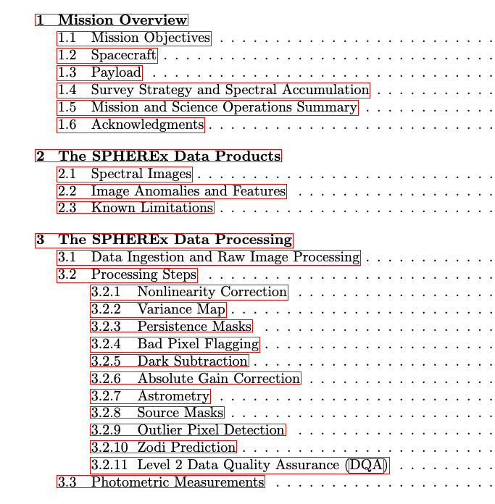
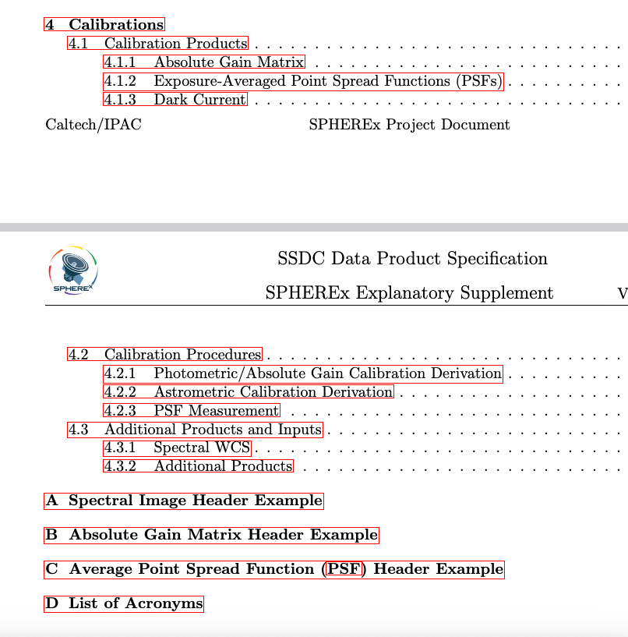
Explanatory SupPlement

Slide 15
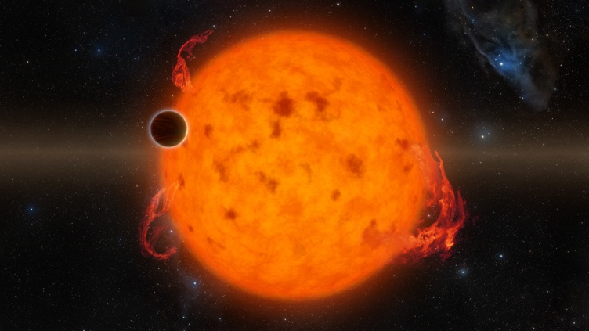
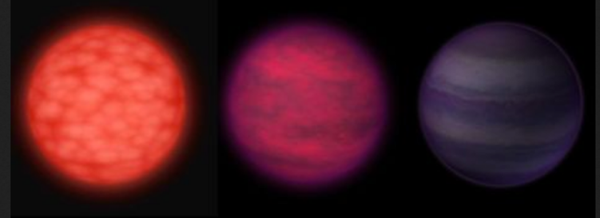
Precision Stellar Properties Catalog
Rachel Akeson, Davy Kirkpatrick, Michael Werner and Zafar Rustamkulov
Goals: To produce a catalog of stellar SED fits and physical properties for:
(1) ~2 million main sequence stars from exoplanet surveys (Kepler, K2, TESS/PLATO)
  Use survey samples for known properties, especially multiplicity
  (2) ~3,000 stars and brown dwarfs in a volume-complete 20-pc census, with other nearby stars and brown dwarfs at larger distances to provide a 10,000-object sample.

Slide 16
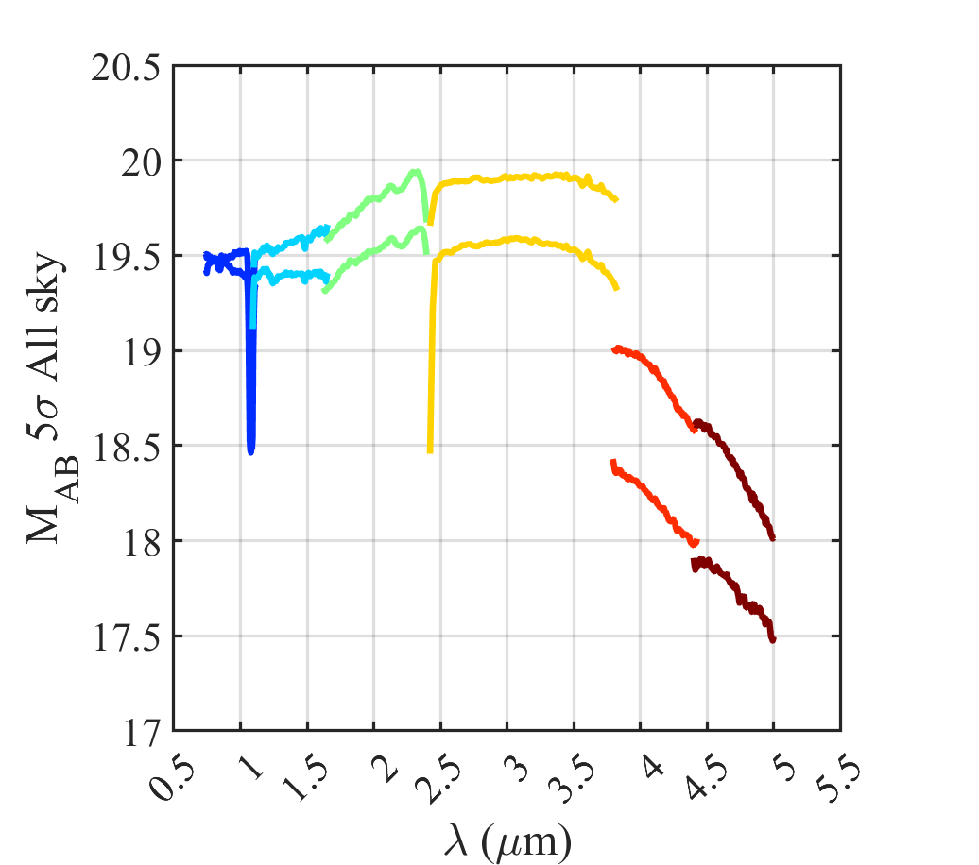
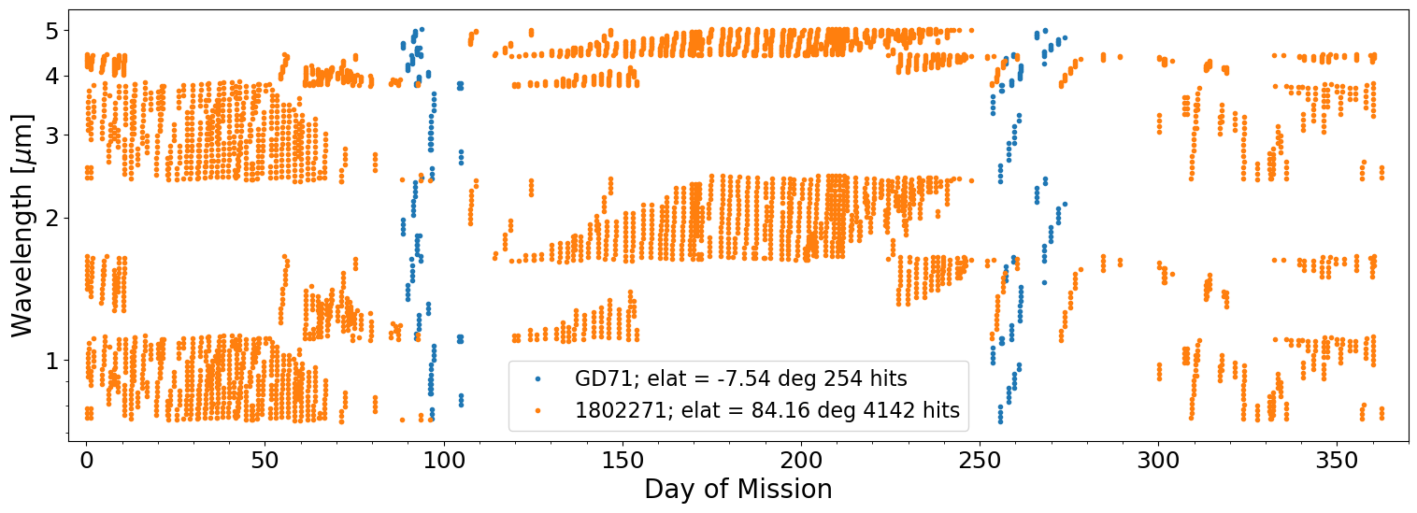
What Will SPHEREx do for YOU?
SPHEREx will measure the flux in 102 channels for every object above the sensitivity thresholds between 0.75 and 5 microns
  Spectral resolution is sufficient to detect (but not resolve) standard lines in the near-infrared: CO, H2O, methane
Considerations for YSO’s
  Spatial resolution: Pixel size is 6” so close binaries will be difficult to deconvolve
  Temporal sampling: Per object measurements are NOT contemporaneous
Example of spectral sampling timing over 1 year for two sources: near the deep field (orange) and in the all-sky survey (blue)

Slide 17
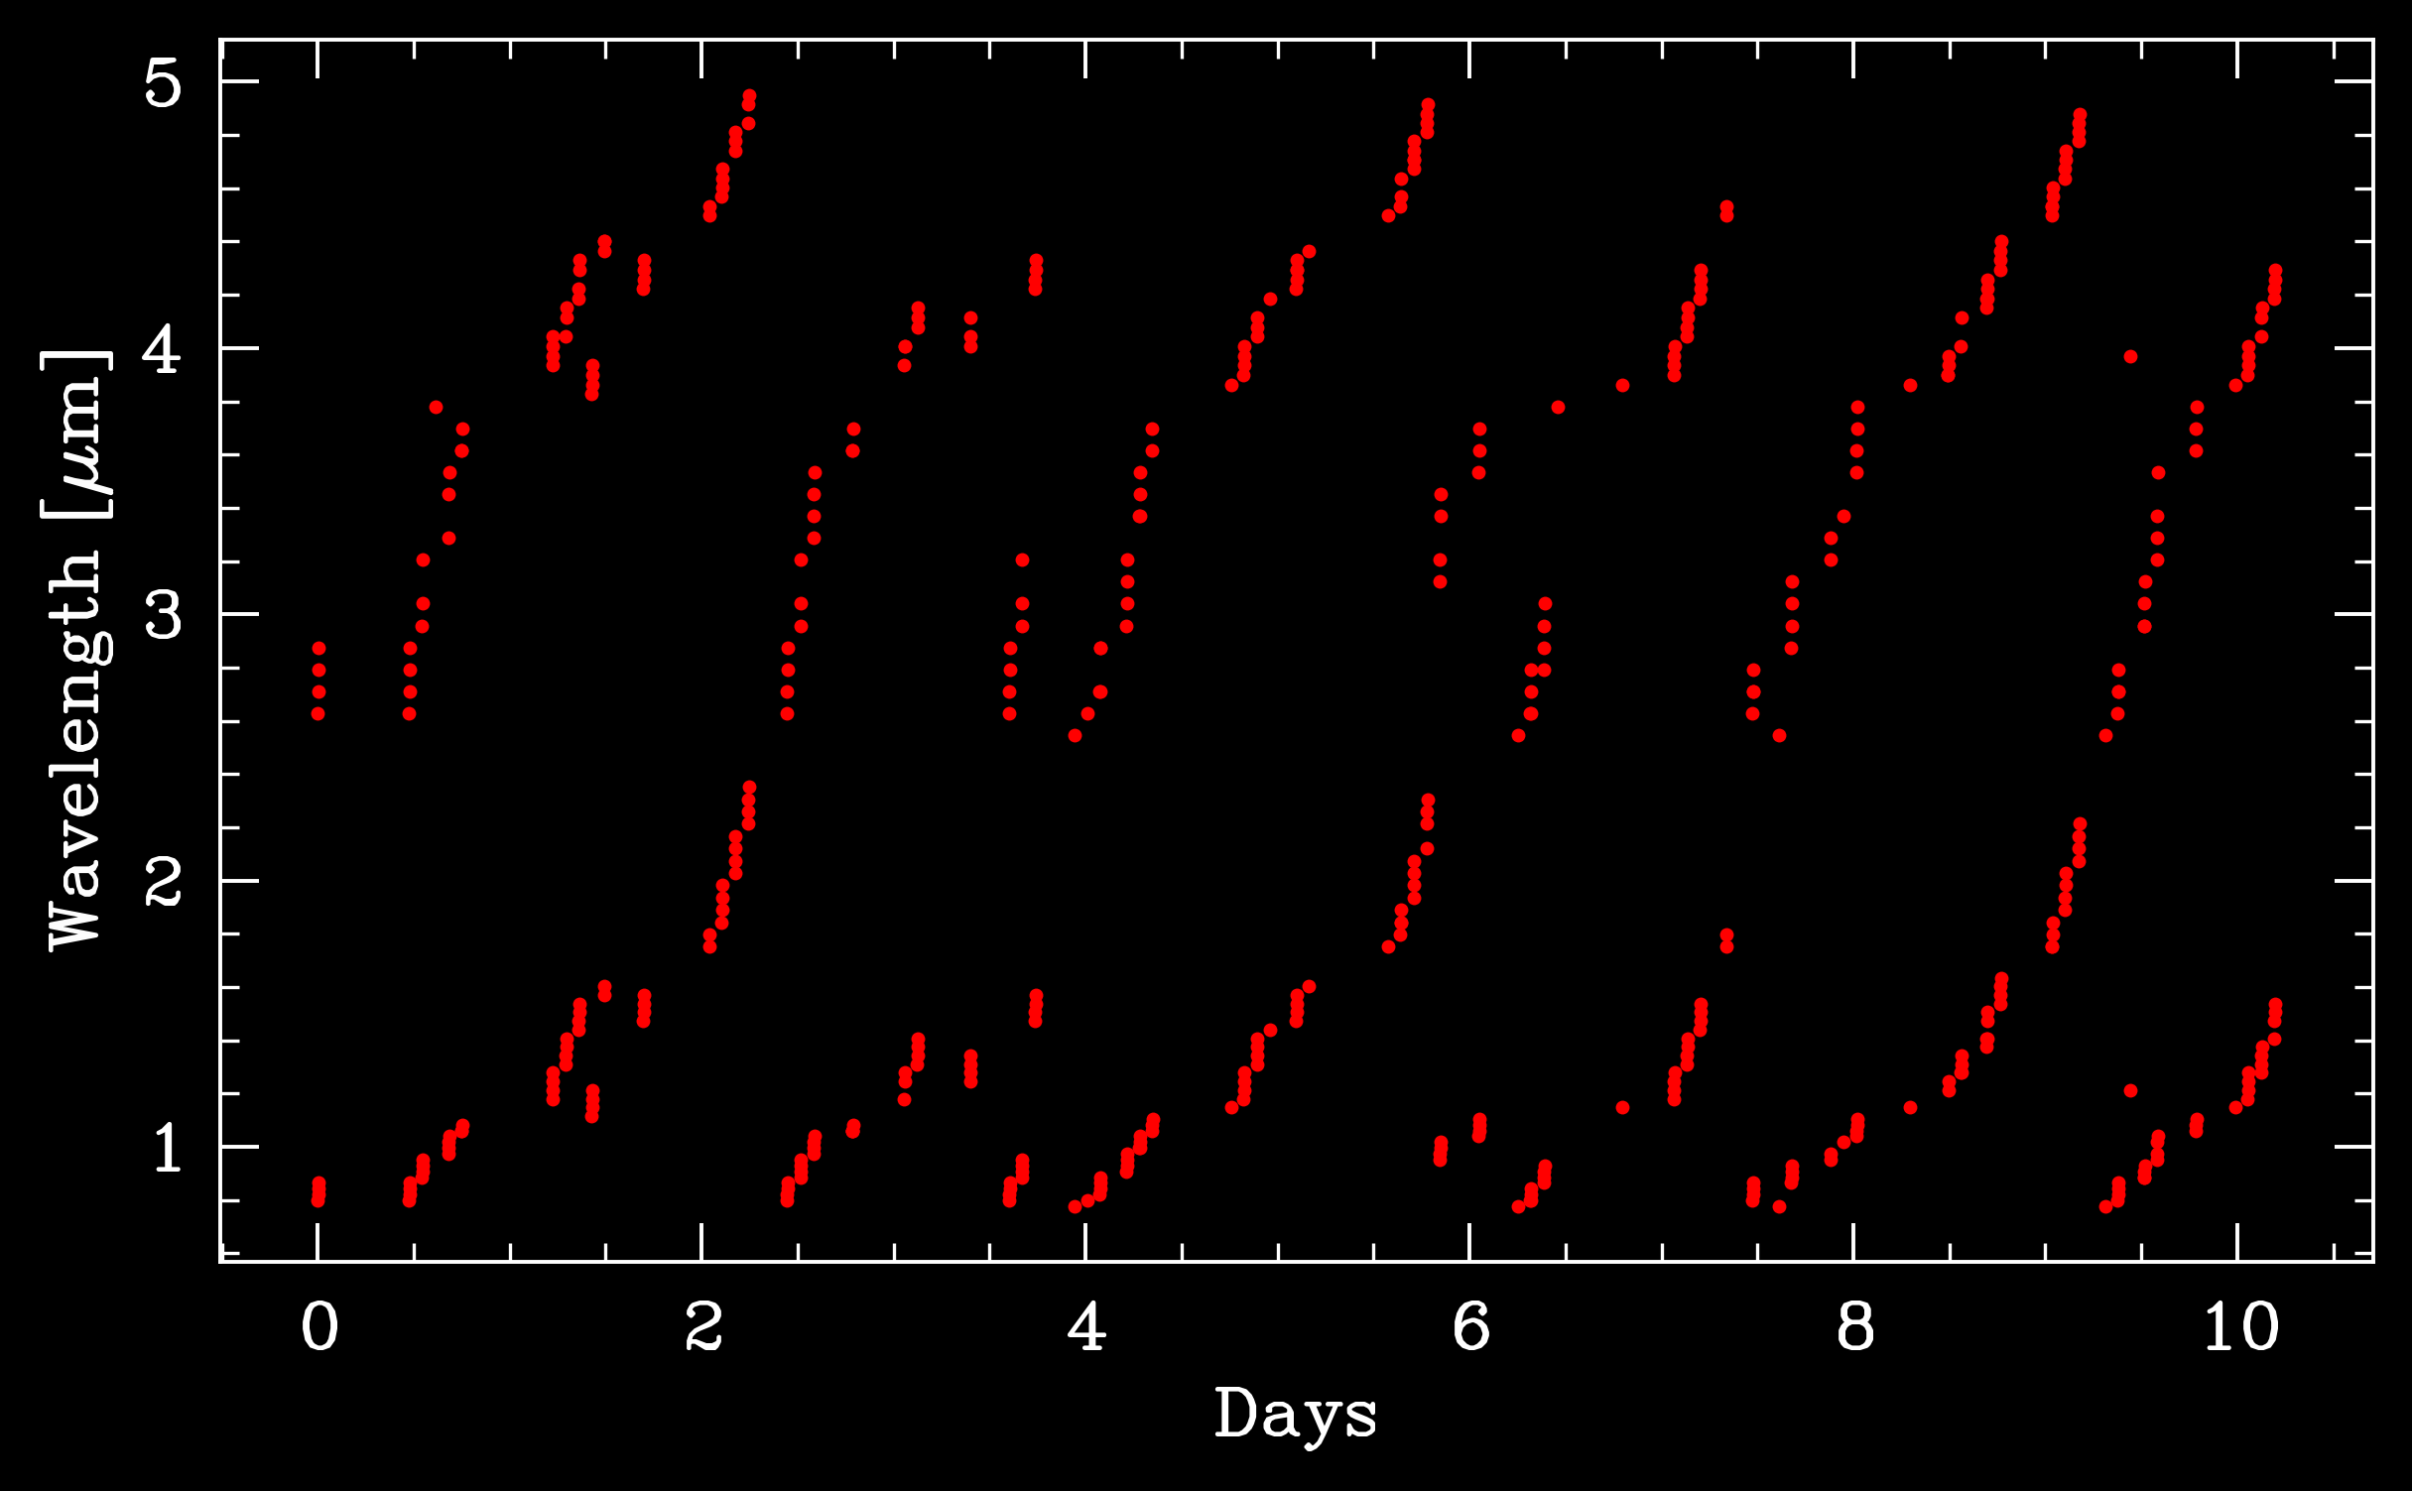

Slide 18
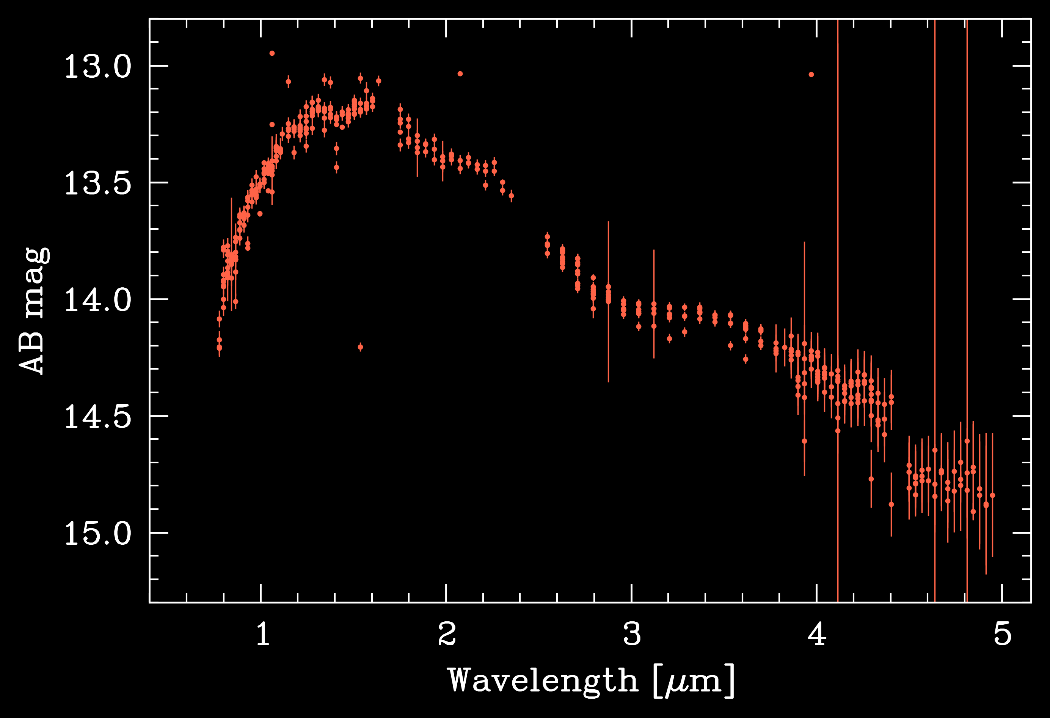

Slide 19
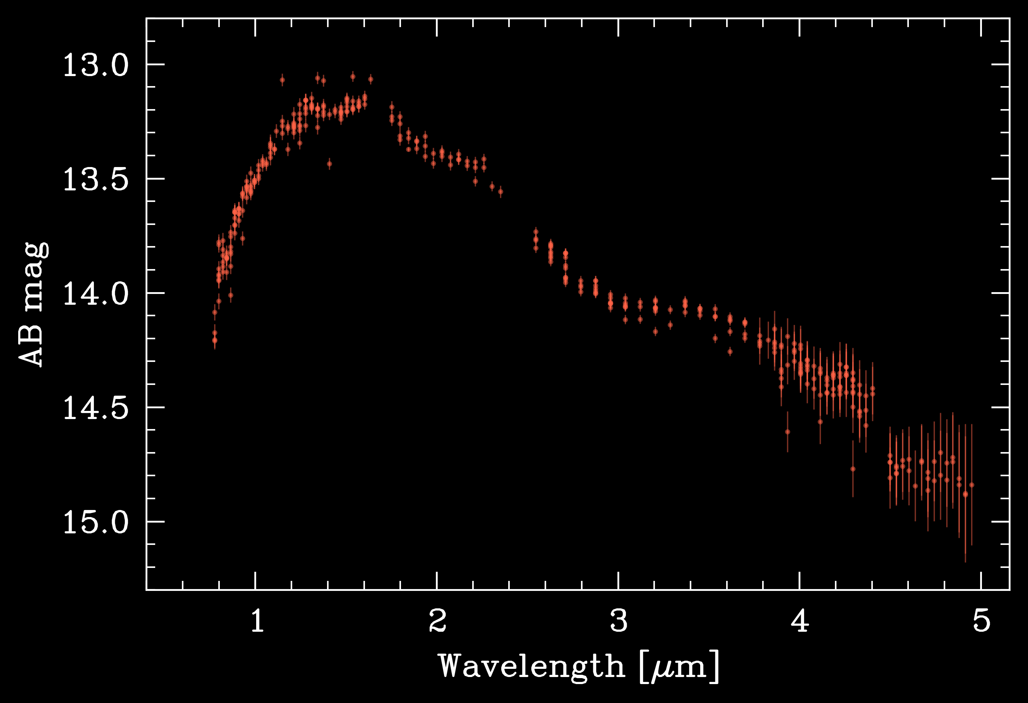

Slide 20
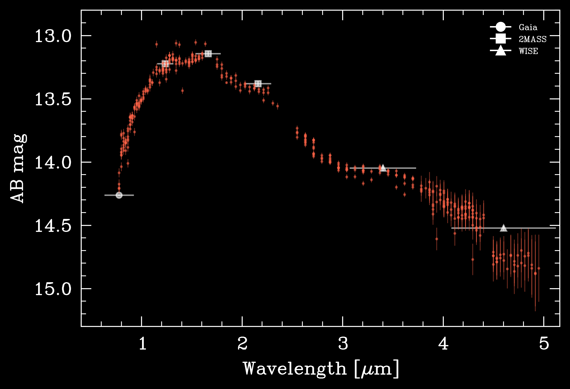

Slide 21
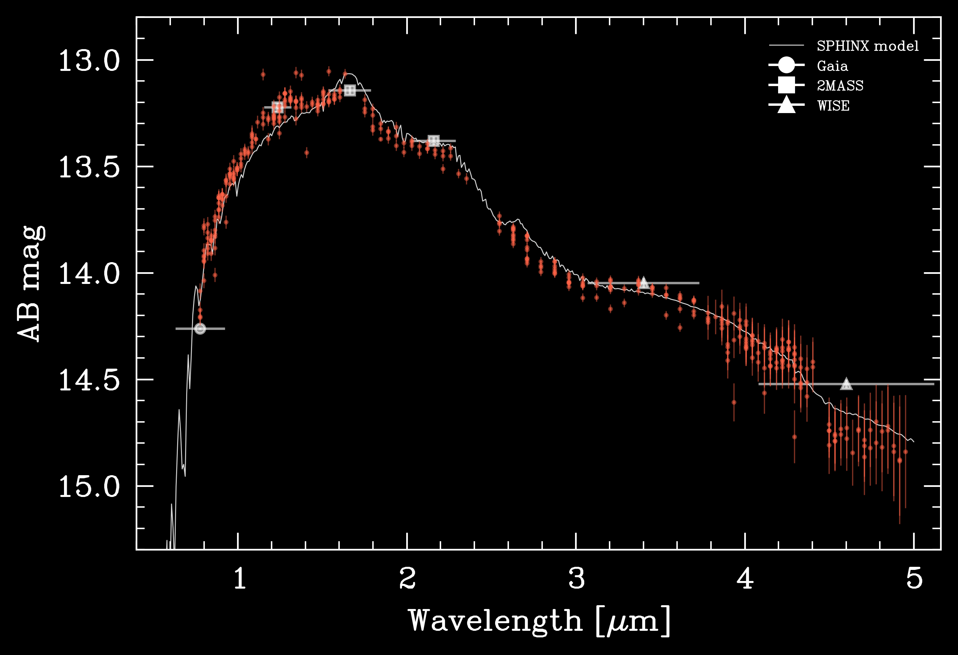

Slide 22
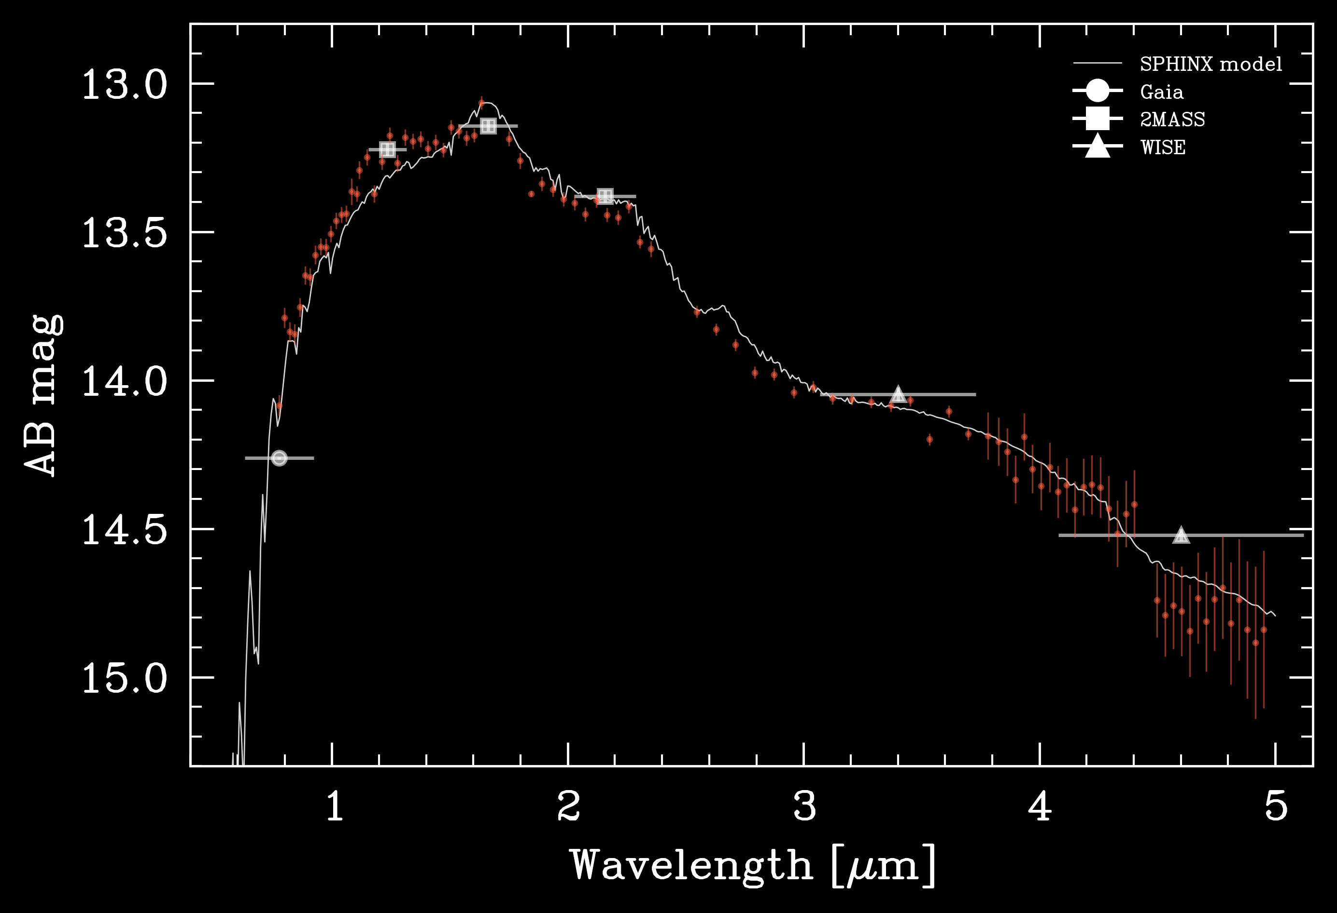

Slide 23
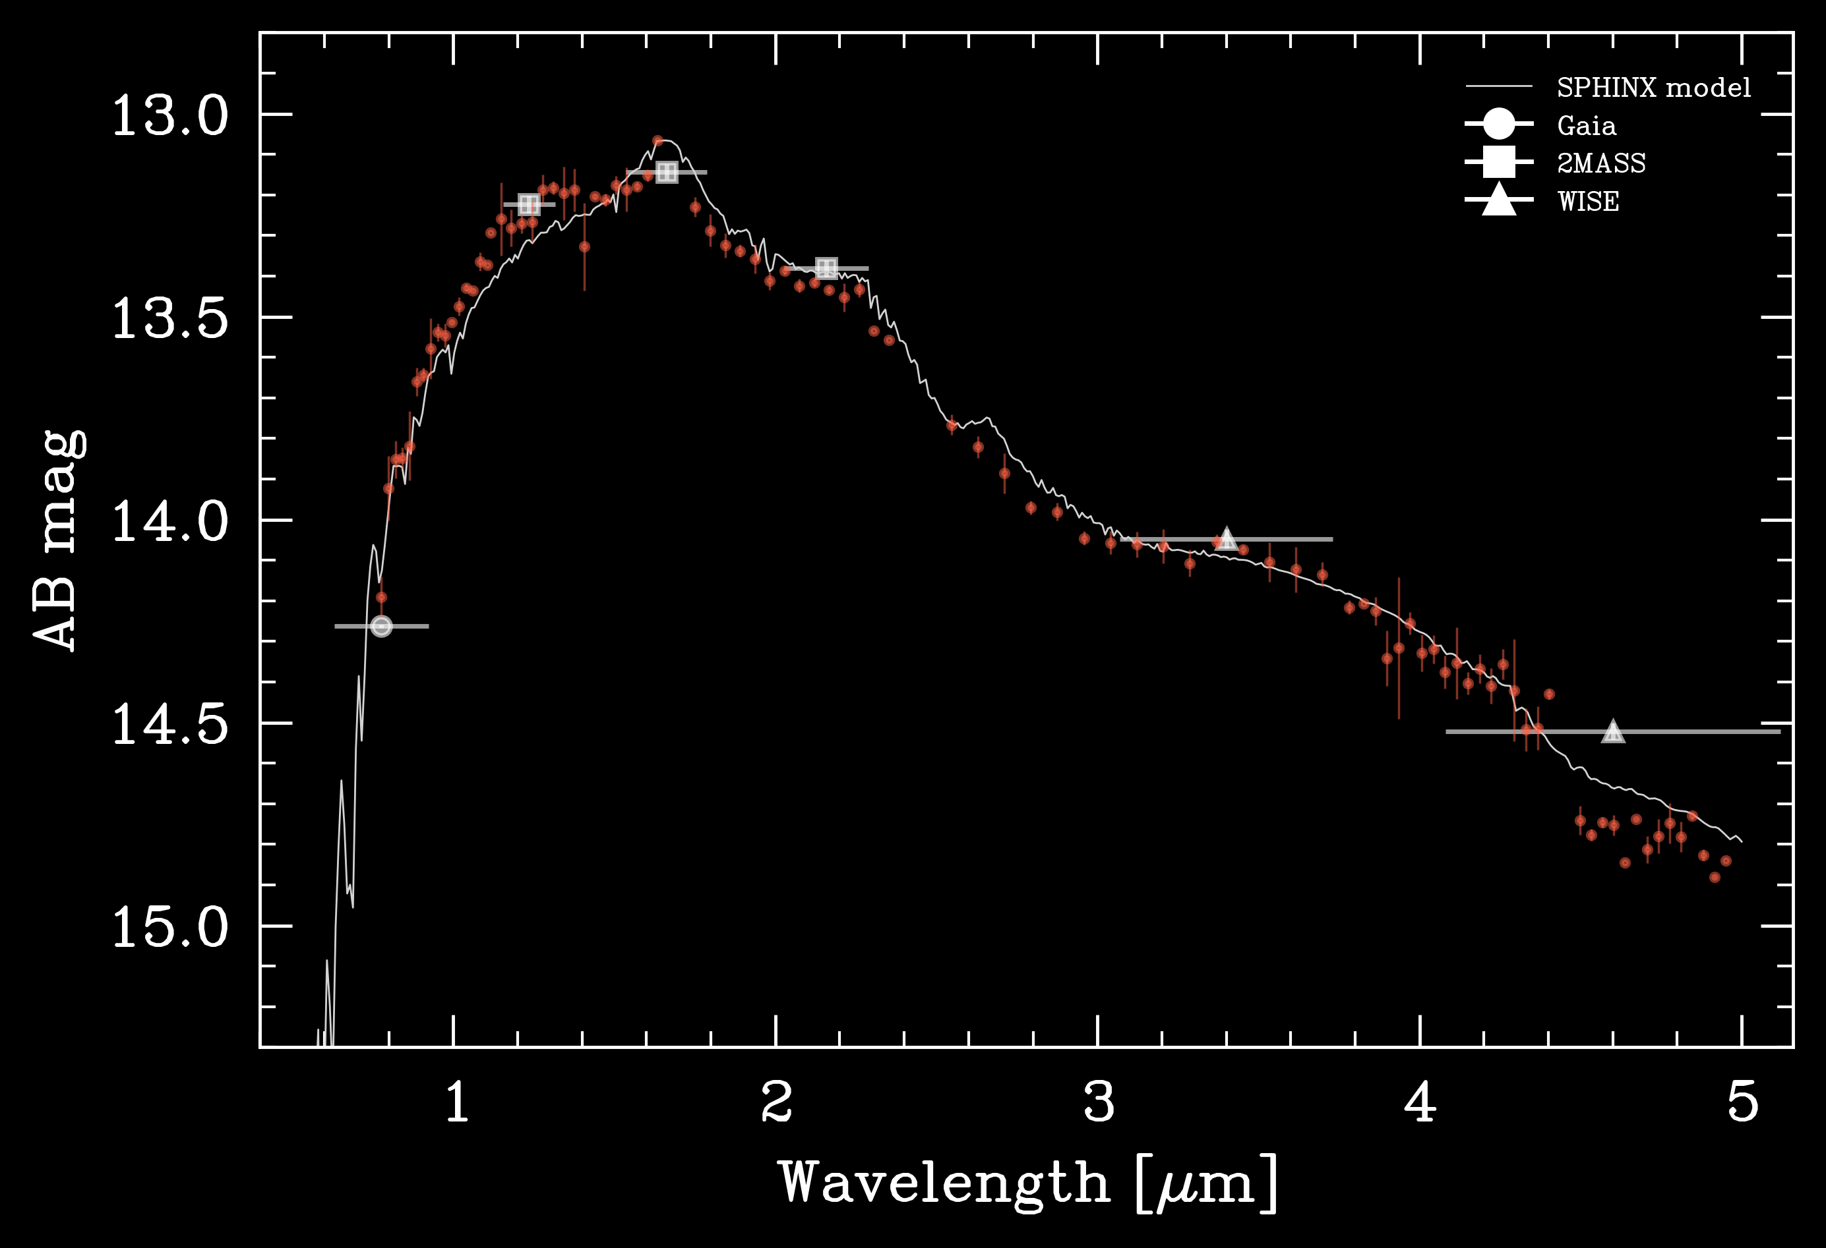

Slide 24
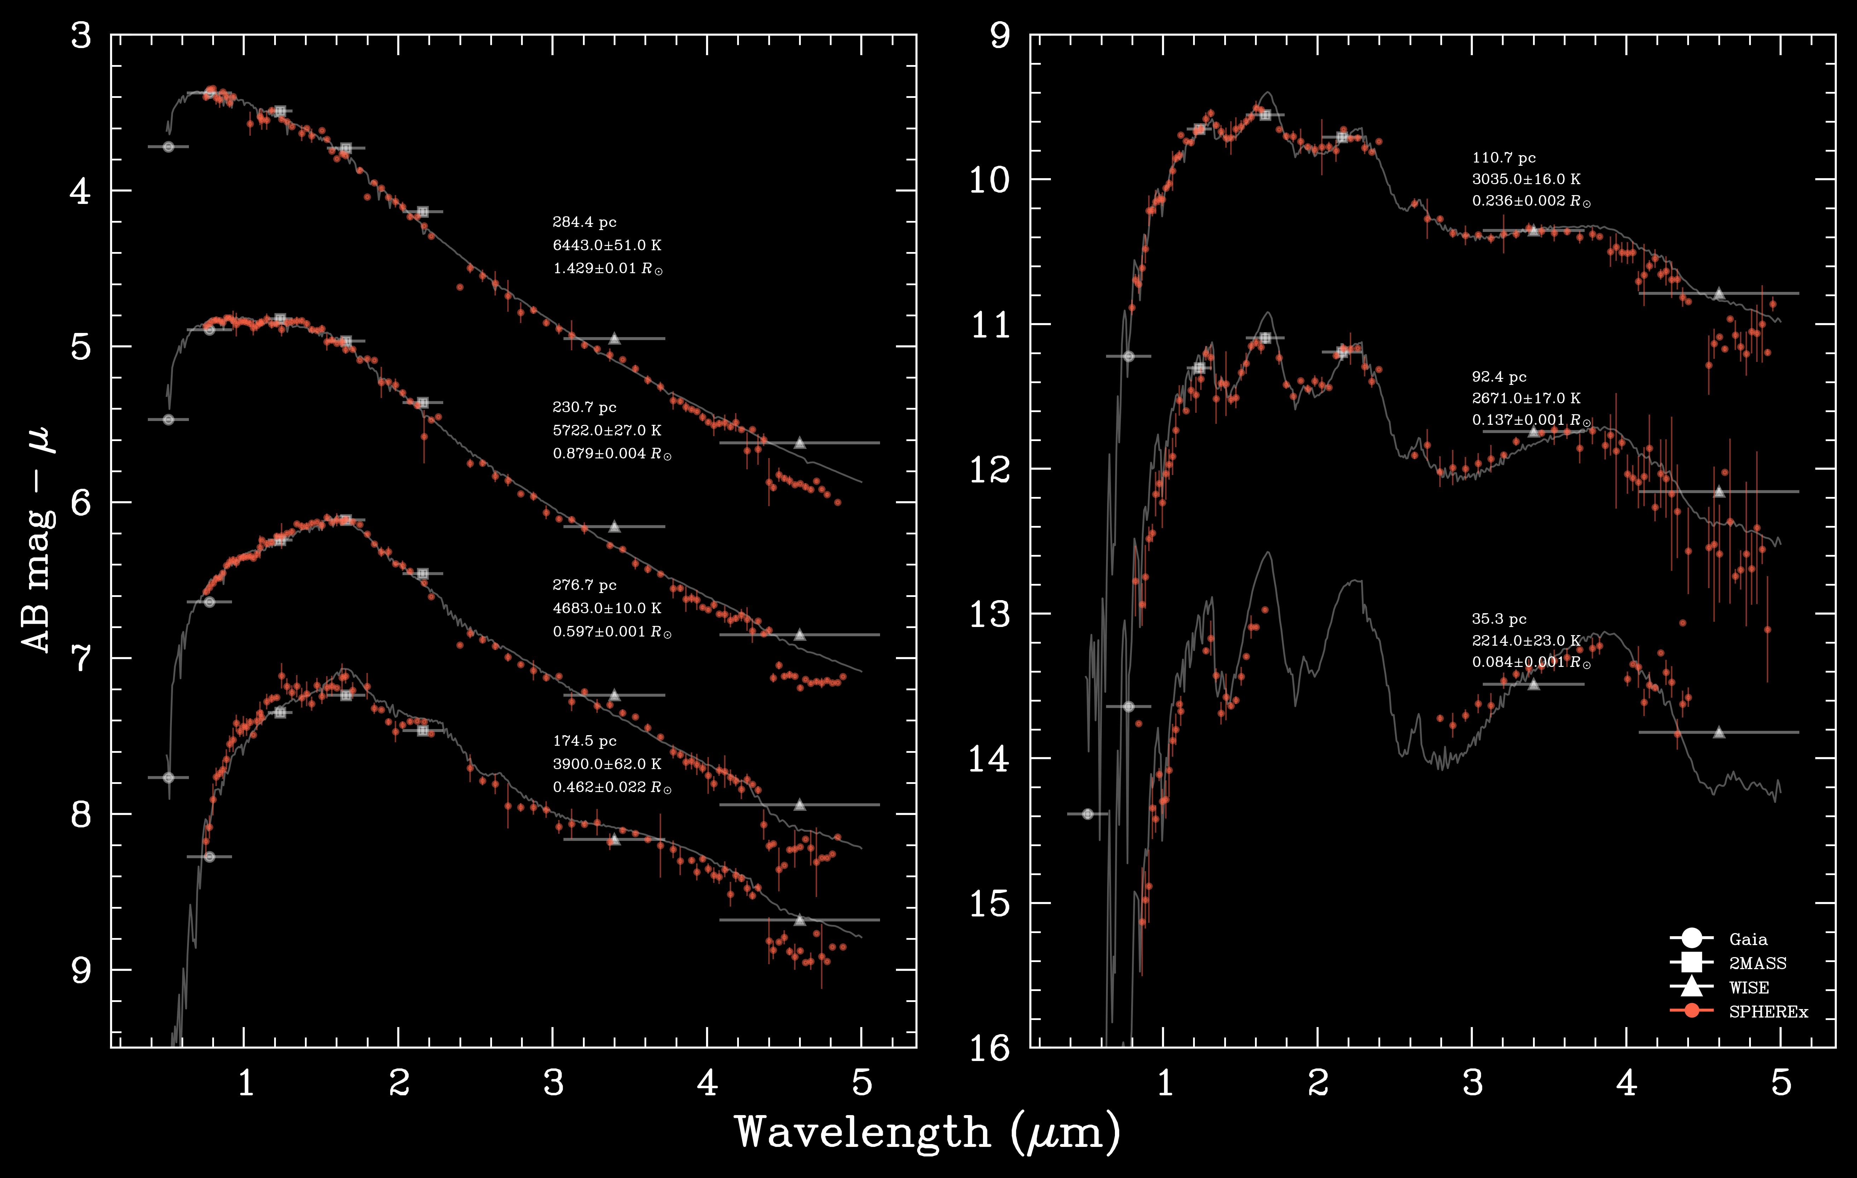

Slide 25
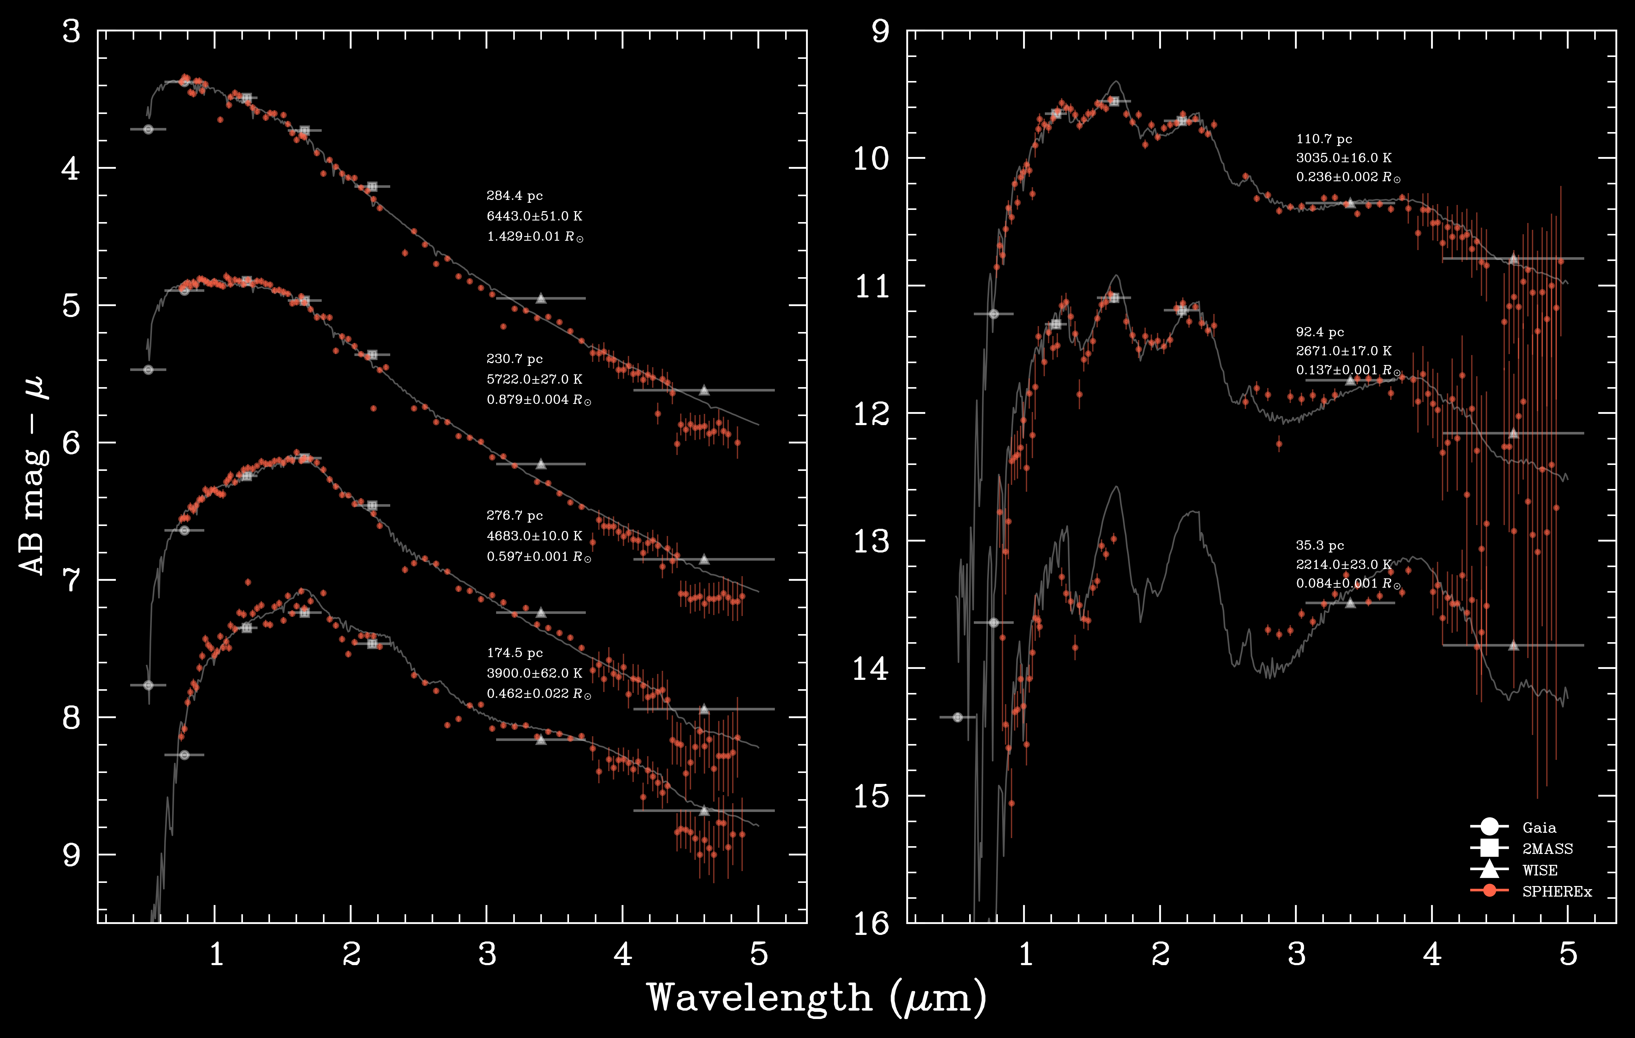

Slide 26
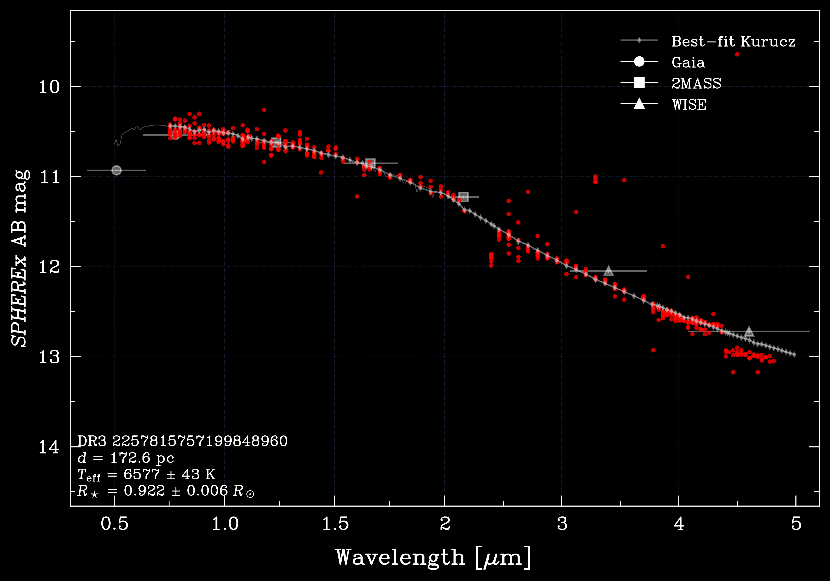

Slide 27


Slide 28


Slide 29


Slide 30


Slide 31


Slide 32


Slide 33


Slide 34


Slide 35


Slide 36


Slide 37

So, do we see the White Bear?
Band 4, 100-image deep stack

Slide 38

So, do we see the White Bear?
Band 5, 100-image deep stack

Slide 39
So, do we see the White Bear?
Band 6, 100-image deep stack

Slide 40
Summary
SPHEREx + Gaia give ~15K T_{eff} and <1% R* constraints for FGK
Sensitive to spectra of nearby BDs and cool M dwarfs
Spectra agree with WISE/2MASS
Data flags extremely effective at removing outliers
Visit-to-visit scatter is mostly accounted for by variance layer (systematics at the ~0.05 mag level)
Simple aperture photometry works well, to ~0.05 mag
We can stack images to search for faint brown dwarfs

