Slide 1
The XMM-Newton Science Archive a door to data and catalogues
Nora Loiseau + M. Guainazzi – XSA Archive Scientist and SOC
Elena Colomo et al. – XSA Software Engineer
European Space Astronmy Centre / ESA - Spain
https://www.cosmos.esa.int/web/xmm-newton/home
http://nxsa.esac.esa.int/nxsa-web/#search

Slide 2
  The Data Content
  Data Exploration
  Data Access

Slide 3
XMM-Newton Data from Instruments
6 astronomical instruments acquire data simultaneously:
3 European Photon Image (EPIC) CCD cameras (PN, MOS1 and MOS2): with 3 Science Filters (+cal.) and several operating modes (FF, Large window, Small window, Timing), most efficient in the 0.2-10.0 keV energy range → Images, Spectra, Light curves
2 Reflection Grating Spectrometers (RGS), most sensitive in the 0.3 to 2.1 energy range → High Resolution Spectra
an Optical Monitor, with 7 broadband filters in the Optical and UV bands → Images, Spectra, Light curves
plus a Radiation Monitor

Slide 4
XMM-Newton Data Files
Basically 3 types of data are stored in the archive:
ODF observations data files: semi-raw data (housekeeping Telemetry)
SDF slew observations data files: semi-raw slew data
PPS pipeline processed pointed and slew observations
+ catalogues
PPS Data Files Structure:
http://xmm-tools.cosmos.esa.int/external/xmm_user_support/documentation/dfhb/ (table 37)
Field | Description
X | P product or C cat cmatch
obsidentif | The observation identifier, 10 digit: PPPPPPOOLL
II | The instrument, or data source, identifier
U | Exposure flag (1 character)
EEE | The exposure number within the observation
TTTTTT | The product type (6 digits)
S | Data subset number (1 character, differentiates energy bands, OM science windows, etc.)
XXX | Source number or slew step number (3 characters, hexadecimal)
ZZZ | File format (3 characters)
XobsidentifIIUEEETTTTTTSXXX.ZZZ

Slide 5
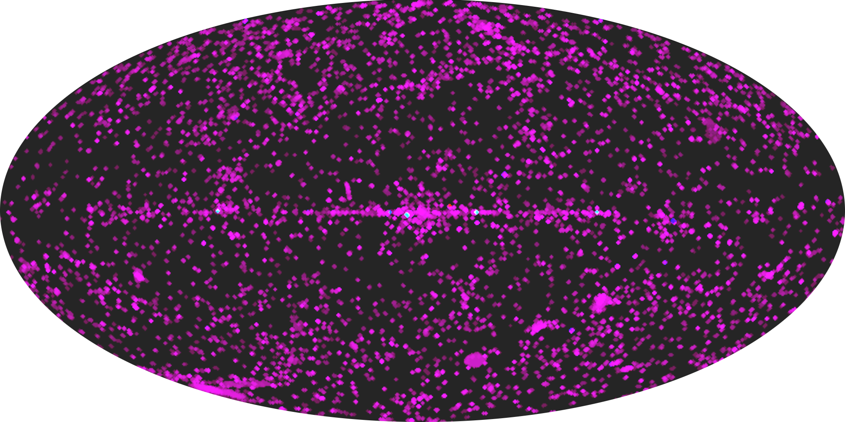
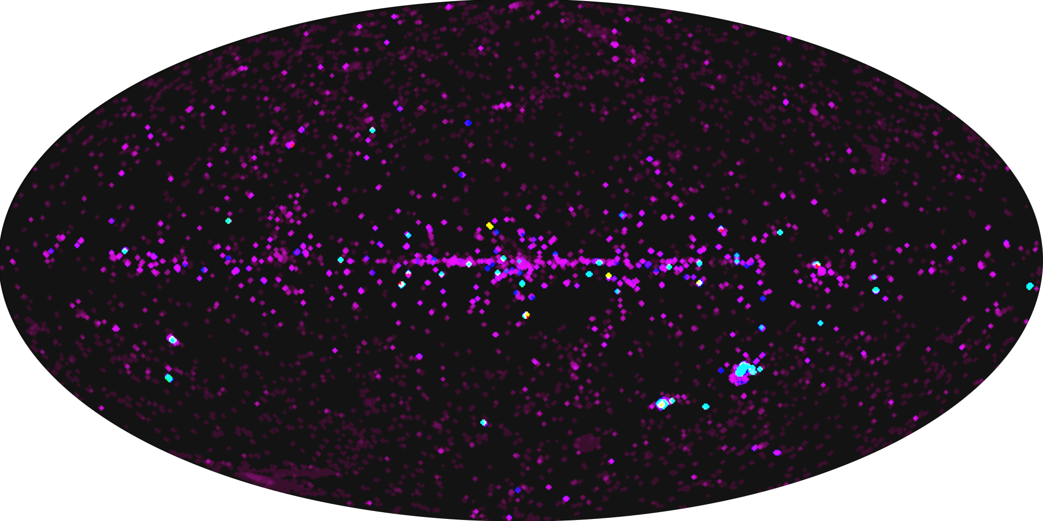
XMM-Newton Catalogues
4XMM-DR10
Fully regenerated catalogues: 1XMM, 2XMM, 3XMM and 4XMM, plus incremental catalogues produced by Survey Science Centre consortium (Webb+ 2020A&A...641A.136W)
4XMM-DR10s
Since DR7 there are also full stacked catalogues produced by AIP- Potsdam +SSC (Traulsen+ 2020A&A...641A.137T)
XMMSL2
Sources from EPIC exposures performed during XMM manoeuvres: Slew Survey Catalogue 2018yCat.9053....0X
XMM-OM-SUSS5.0
OM optical and UV catalogue (Page+ 2012MNRAS.426..903P)
4XMM-DR10
XMM-OM-SUSS5.0

Slide 6
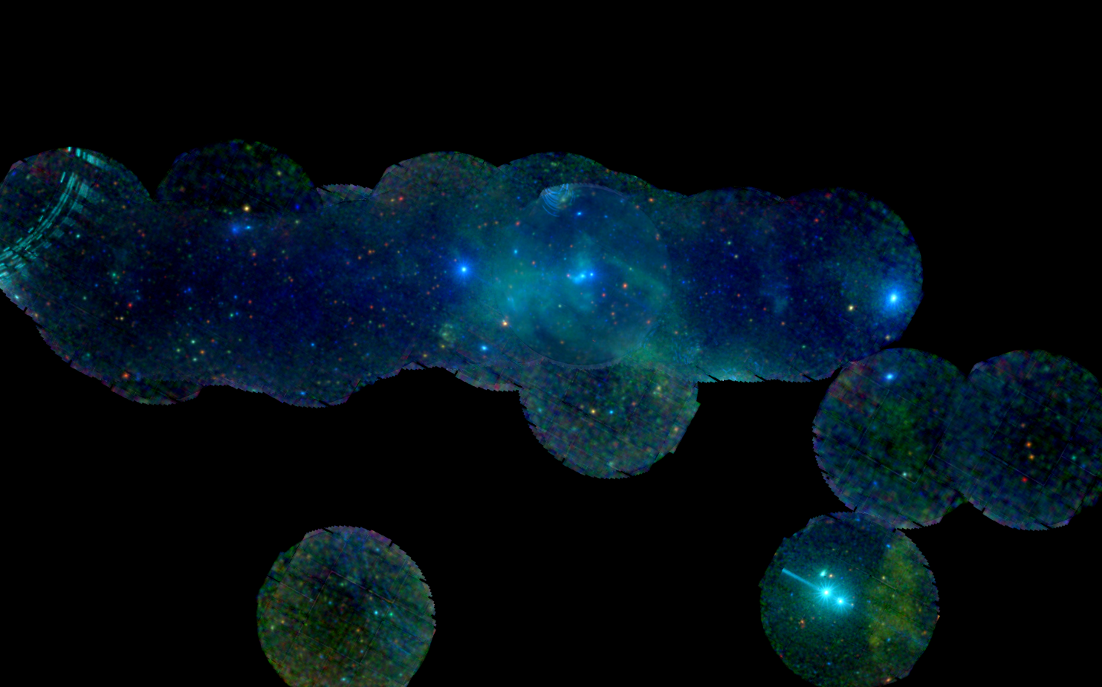
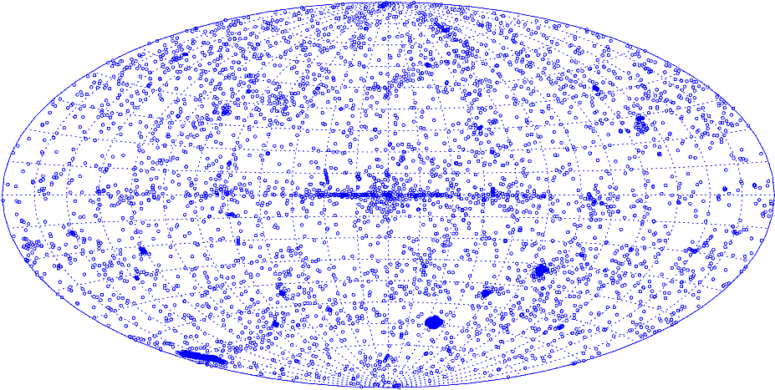
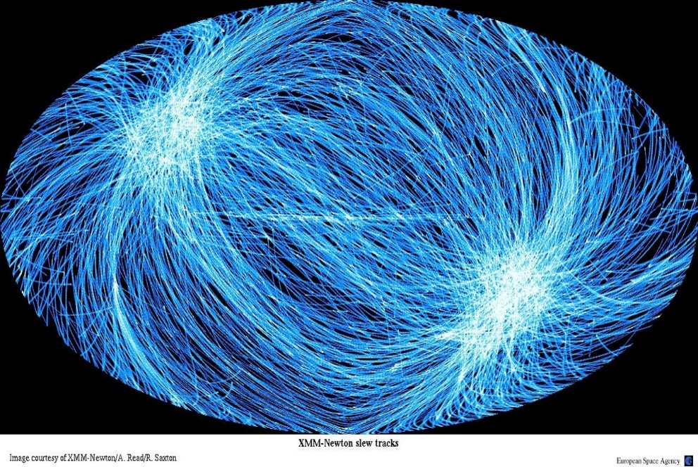
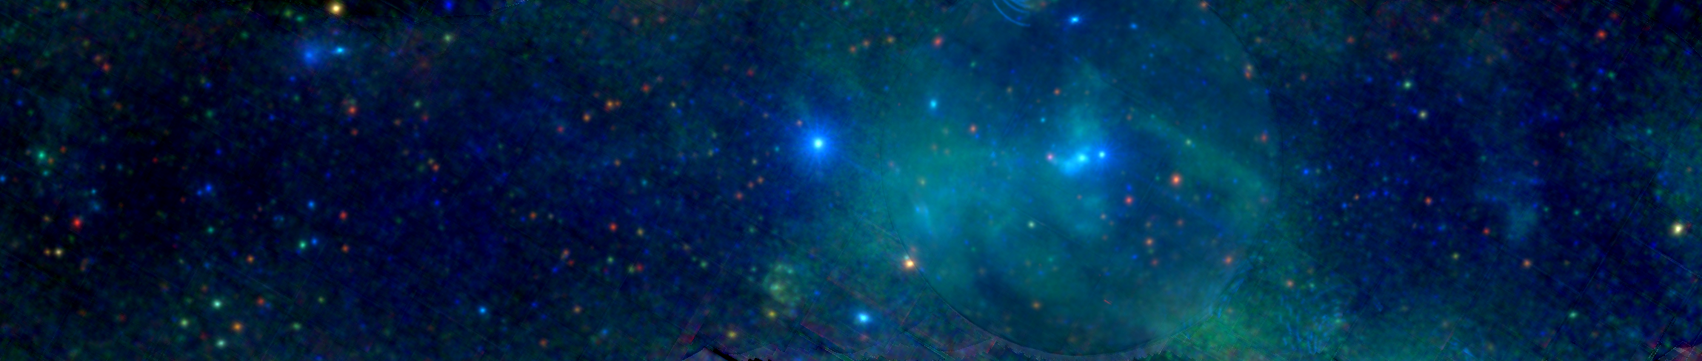
The Contents of the XSA
1- The XSA presently has:
  ODF/PPS of ~ 14,100 pointed science observations
  ~ 948,000 EPIC PPS sources
  ~ 12,620,000 OM PPS sources
  ~ 59,400 Slew Survey PPS sources (since rev. 3138)
  SDF of ~ 4,710 Slew Survey observations
  849,991 EPIC Catalogue sources → 575,158 unique sources (4XMM-DR10 catalogue, http://xmmssc.irap.omp.eu/)
  335,812 EPIC Stacked catalogue (4XMM-DR10s)
  8,863,922 OM Catalogue sources ( XMM-OM-SUSS5.0 catalogue, https://www.cosmos.esa.int/web/xmm-newton/om-catalogue)
  72,352 Slew Survey Catalogue sources (XMMSL2, https://www.cosmos.esa.int/web/xmm-newton/xmmsl2-ug)
  Ancillary info: proposal info, publications (>6700!), etc.
P.Rodríguez
Pointed Observations – P.Rodriguez
Slew observations – A.Read
P.Rodríguez
Notes:
6

Slide 7
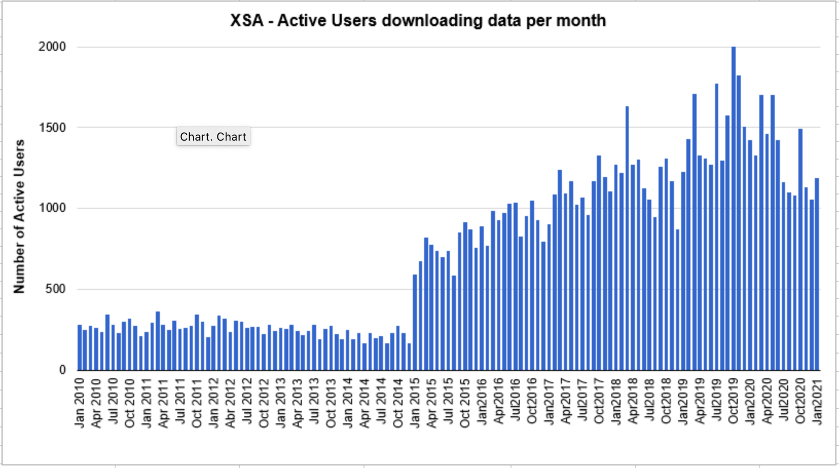
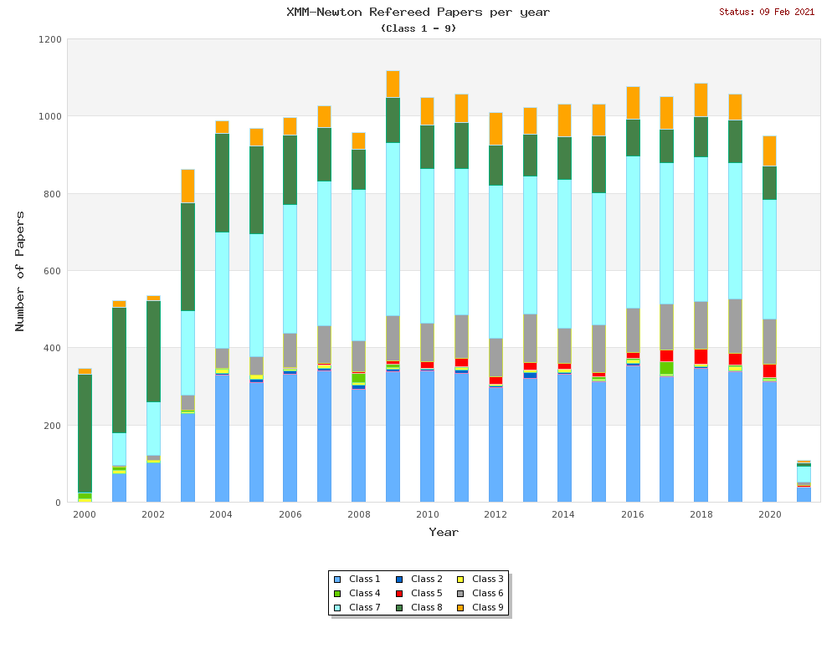
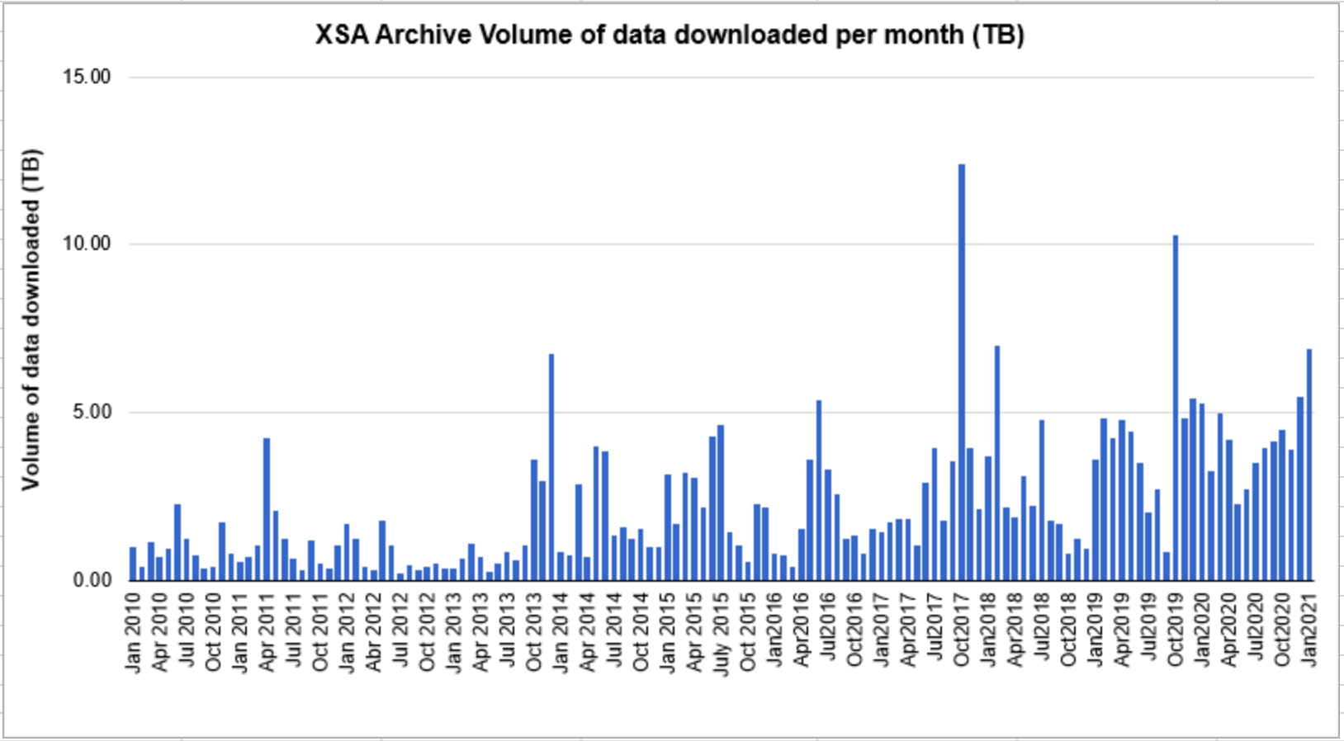

Slide 8
Categories of publications using XMM-Newton data, in bold the ones considered as XMM-Newton Science Publications:
The selected refereed paper
makes use of data from XMM-Newton observations or uses pipeline products
presents catalogues based on XMM-Newton observations
predicts numerical results for XMM-Newton observations, e.g. performs simulations considering the detector response function
describes XMM-Newton, its instruments, operations, software, calibration or scientific impact, including the papers resulting from the "XMM-Newton: The Next Decade" symposia
makes use of primary catalogues (XMM-Newton Serendipitous Source Catalogue, XMM-Newton Slew Survey Source Catalogue, XMM-Newton OM Serendipitous Ultra-violet Source Survey Catalogue, Catalog of Serendipitous Sources Detected with the XMM-Newton OM).
makes use of published XMM-Newton results, especially if the results are highlighted in tables, figures or images
refers to XMM-Newton in connections with a citation to a (refereed) publication
refers to XMM-Newton in general
uses or refers to expressions derived from XMM-Newton (XMMU, XMM/Subaru, XMMLSS, XMM-PRODEX) or mentions XMM-Newton only in the bibliography

Slide 9
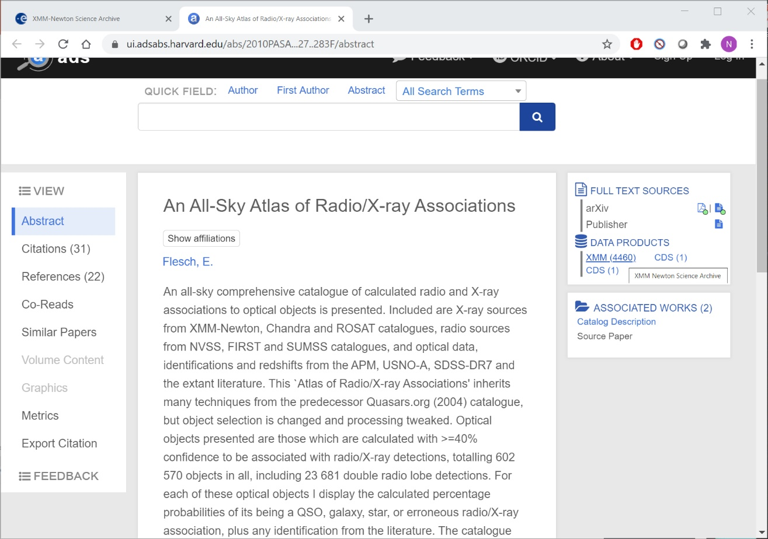

Slide 10
Data Exploration
via the UI

Slide 11
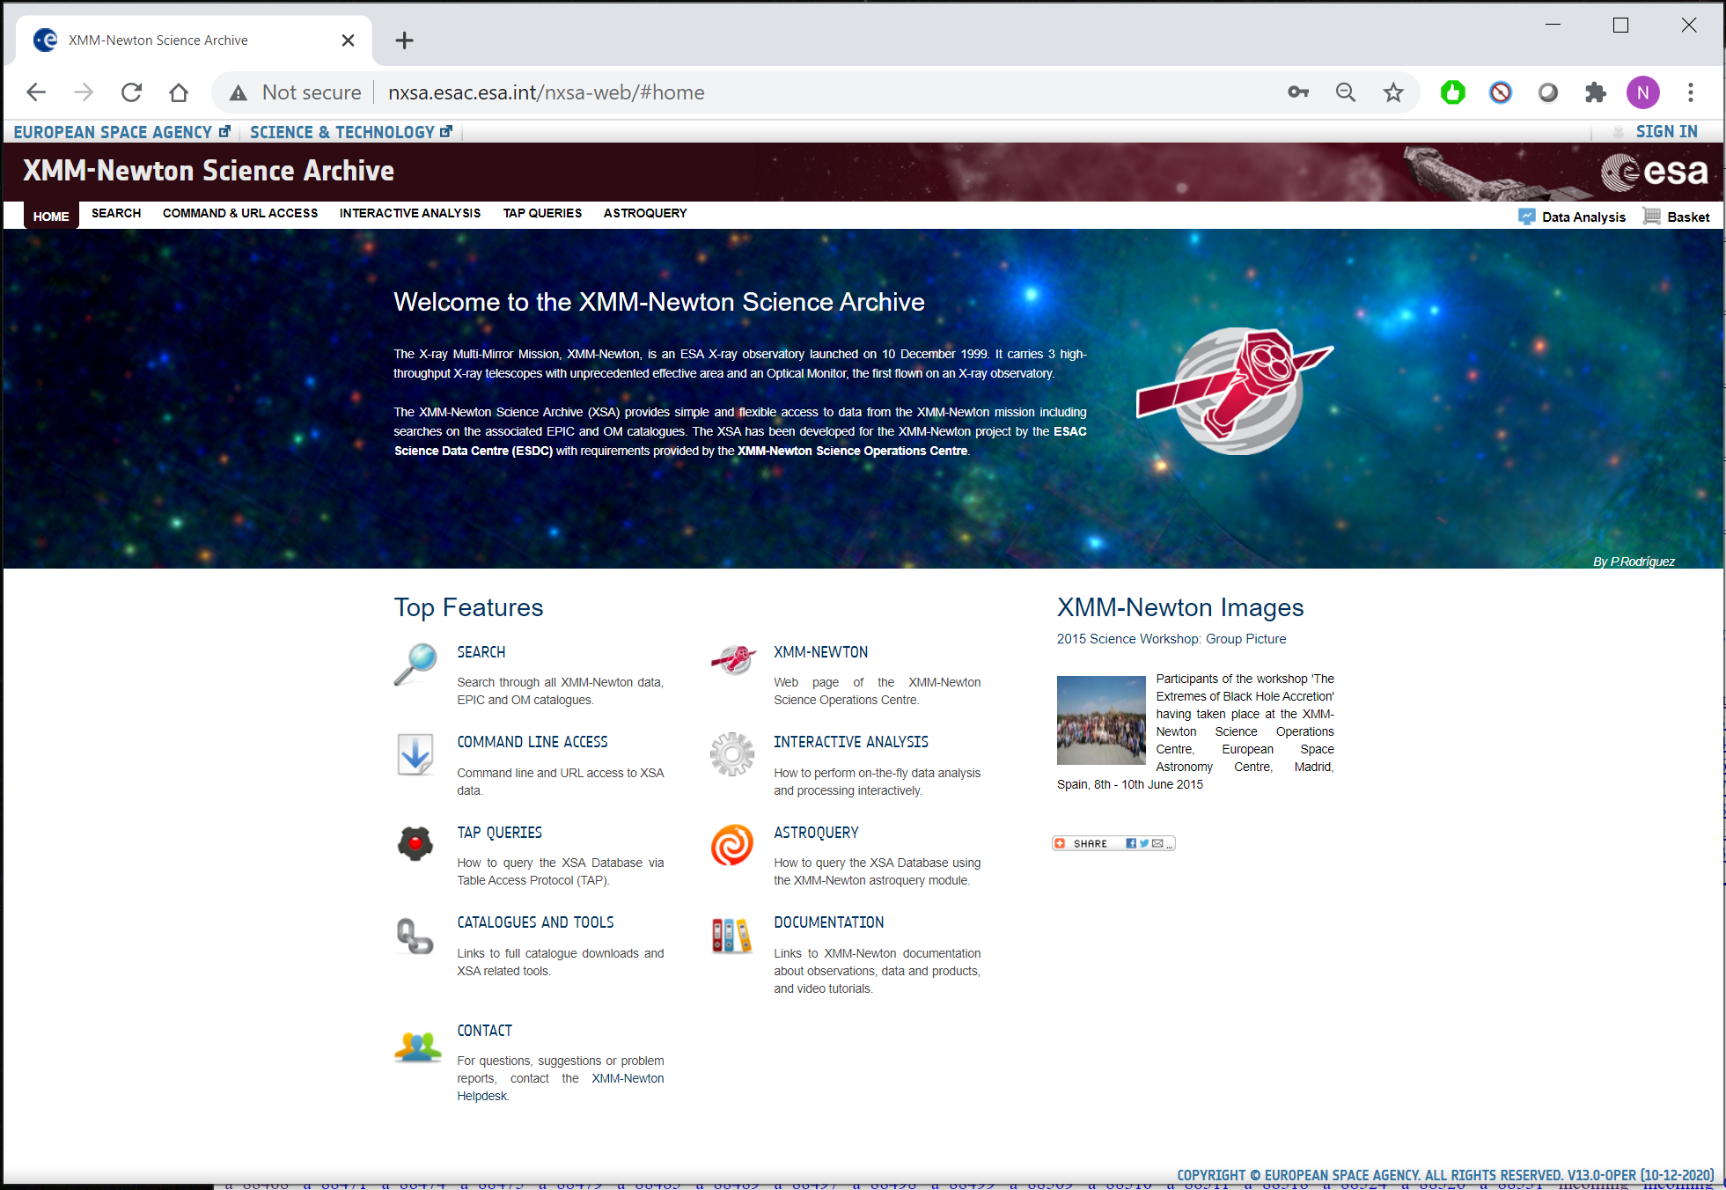
The XMM-Newton Science Archive
Archives with open data access: Archives should provide universal access to space observatory public data (early nineties IUE and HST archive developments: EUROPE-NASA)
IUE Final Archive:
Data archived since the beginning of the mission
Data access first by visiting the centres, then by a telephone link or a “diskette” sent, and at the end (1997) a web access to processed data search and download.
ISO Data Archive:
- WWW Java app (1998) (now rejuvenated in 2020)
XSA Data Archive:
2002 - first released as an ISO-like Java application (A.S.: Matteo Guainazzi 2000-2007, Soft. Eng.: J. Hernández, J. Salgado, P. Osuna, C. Arviset …)
2013 – GWT Web application connected to a postgres DB, allowing new types of data and new functionalities every year, and easy connections to other archives and DB.
Virtual Observatory (VO): some of the tools were first associated with XSA, i.e. recently ESAsky (A.S.: M. Rosa, A. Pollock)
Data Exploration via the User Interface

Slide 12
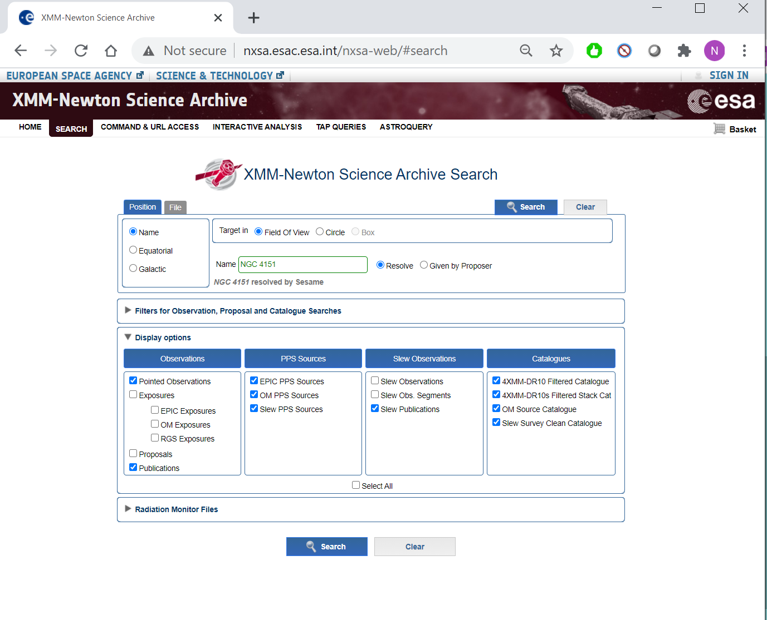
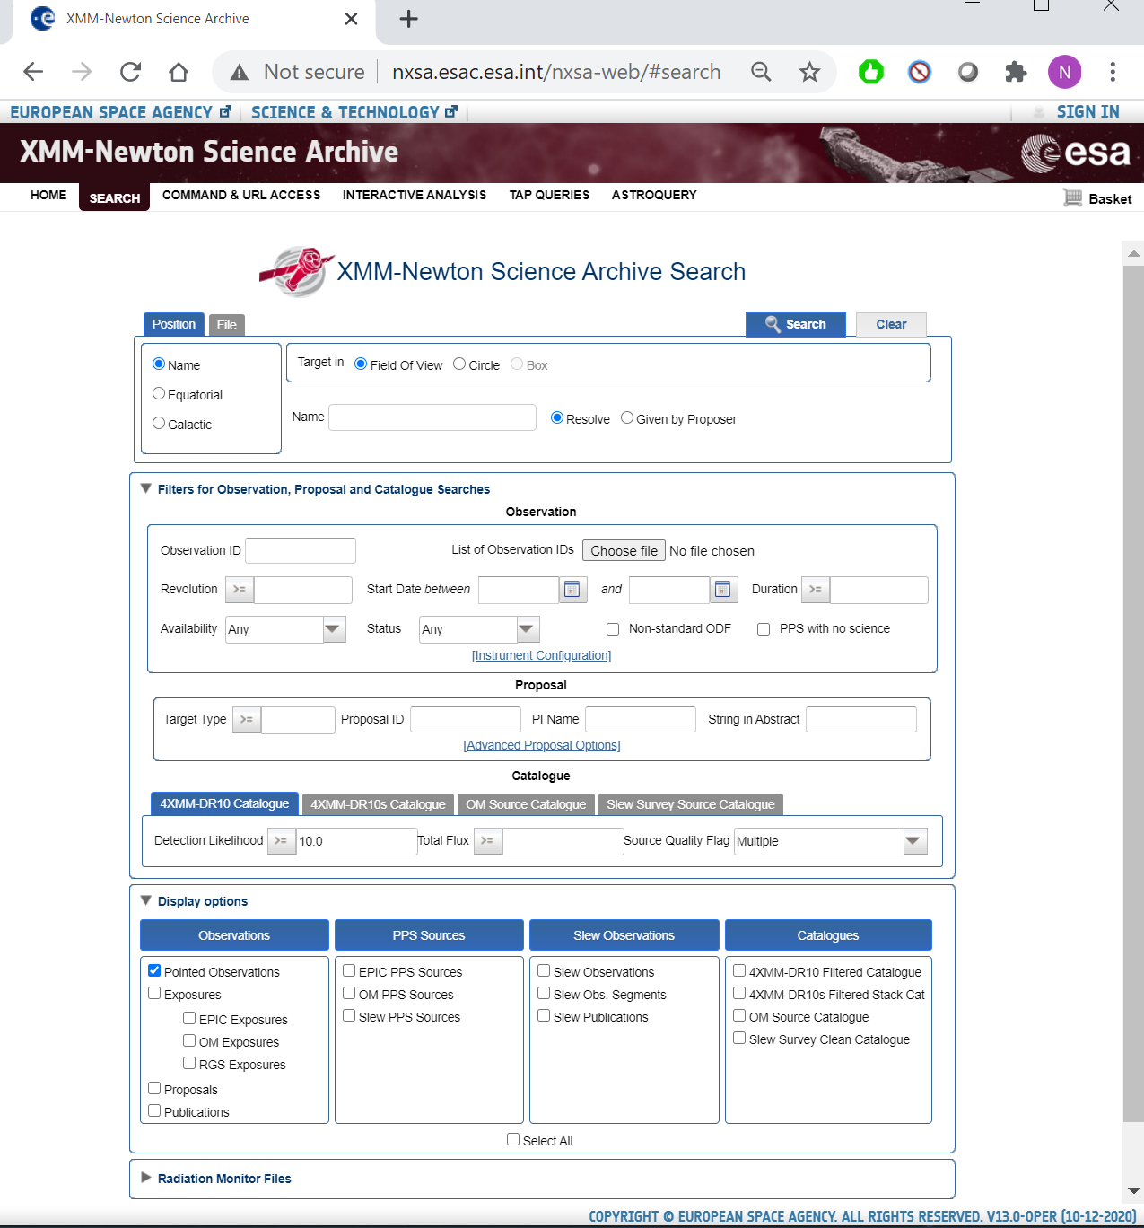
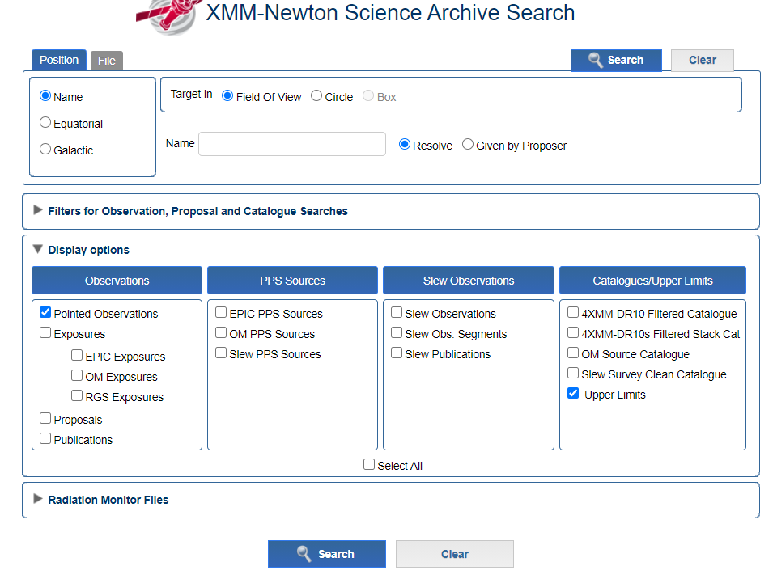
XSA UI functionalities:
The User Interface allows:
Flexible searches
Downloads
Visualization.
On-the-fly interactive data analysis via RISA.
Soon! Upper Limits searches in a parallel UL DB that is updated when new observation are ingested.

Slide 13
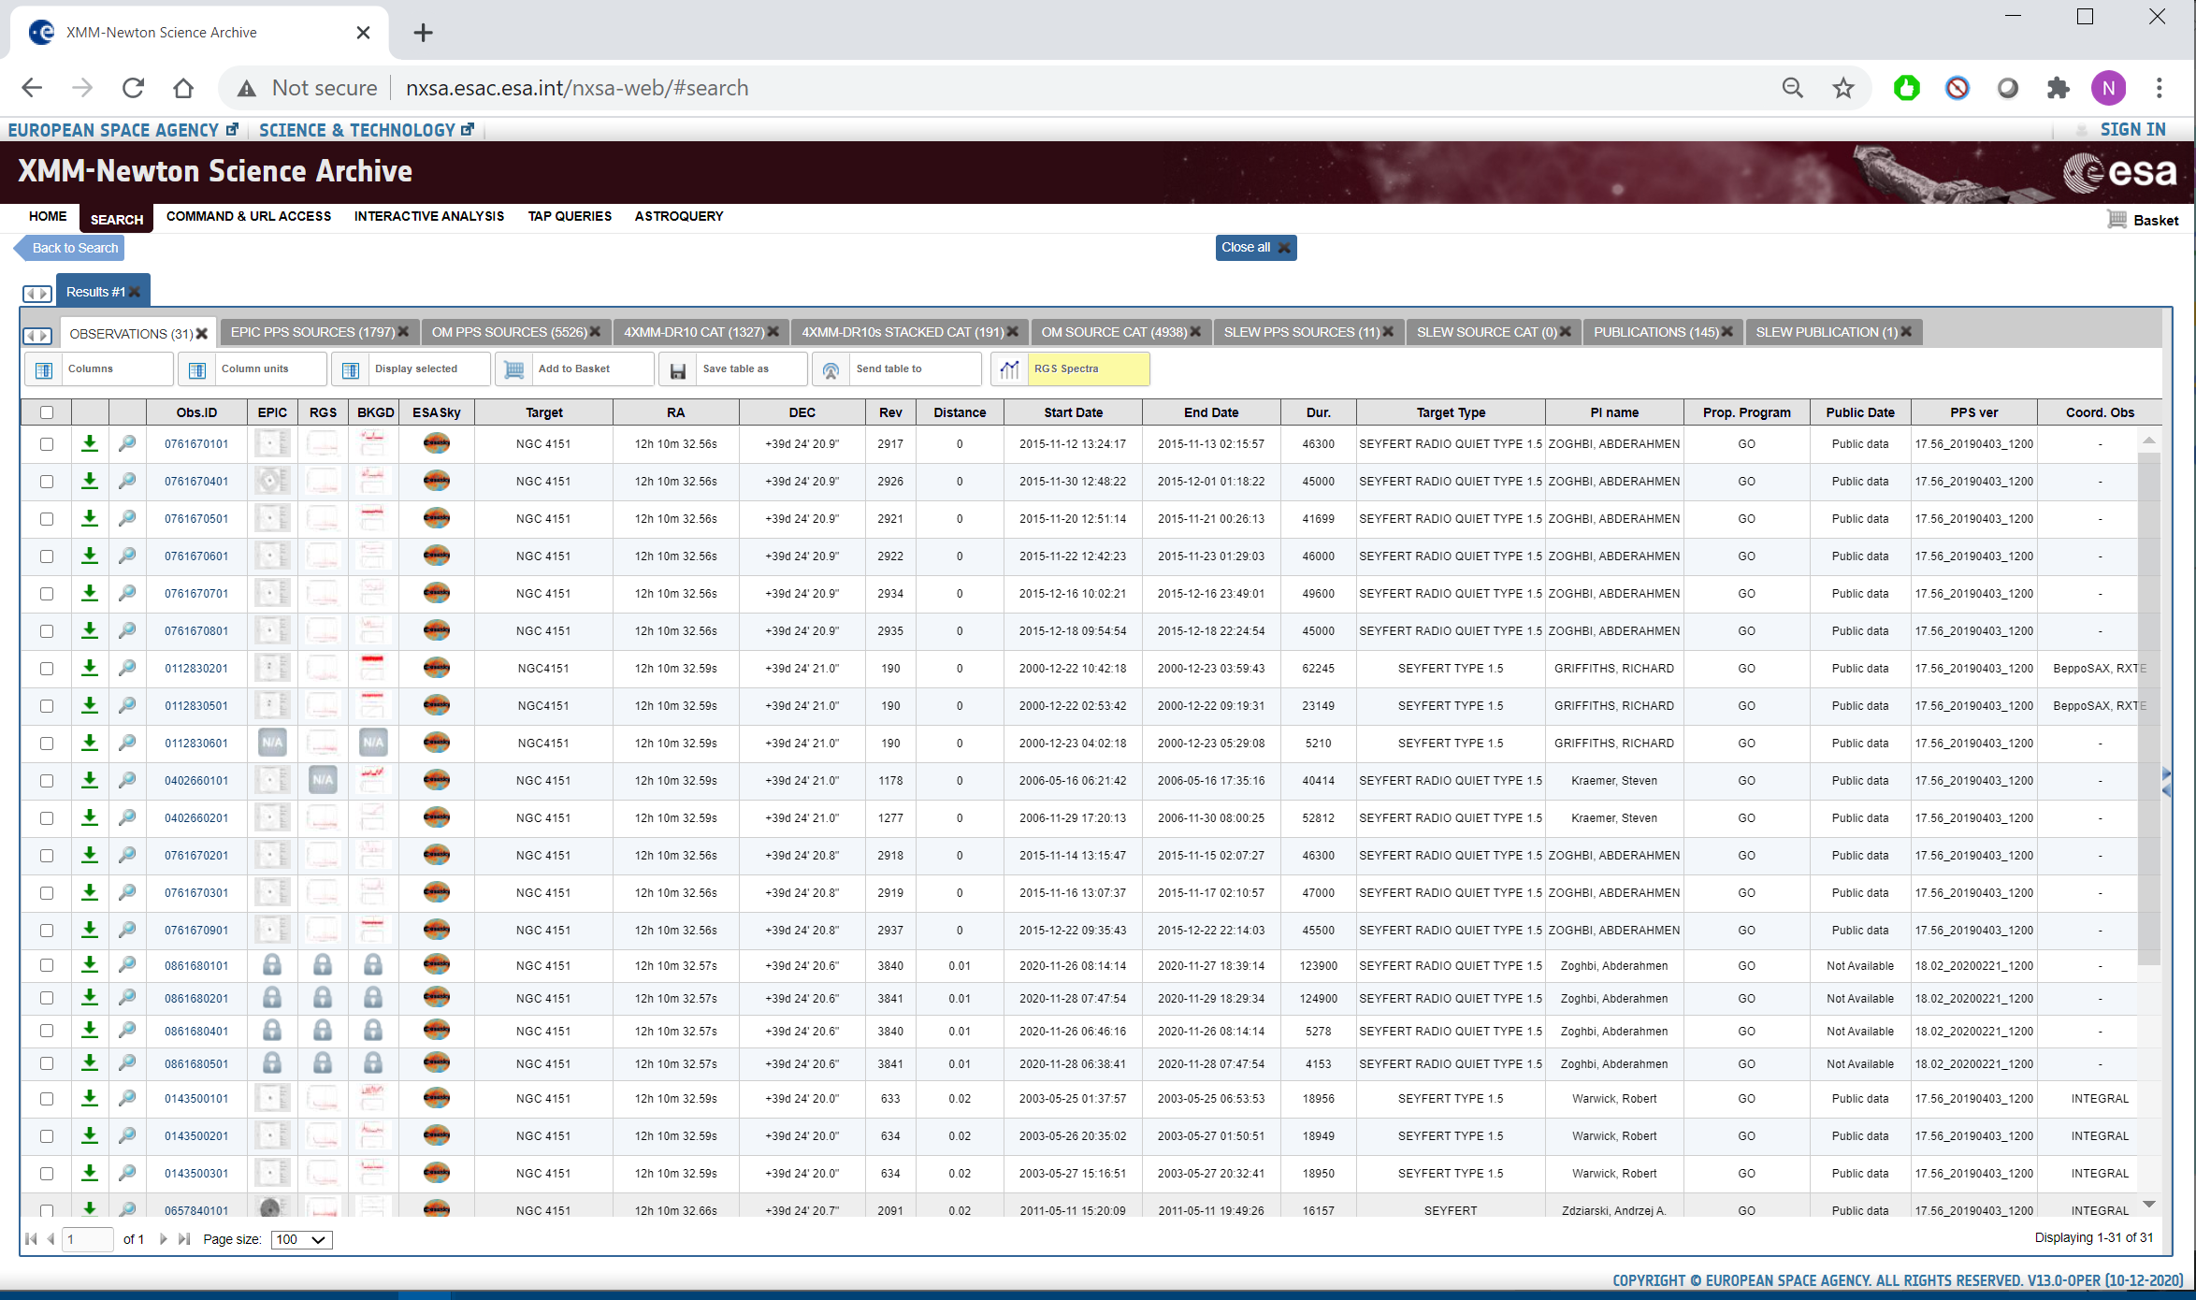
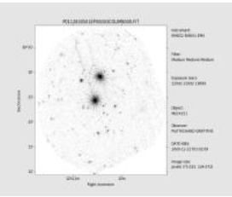
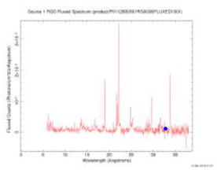
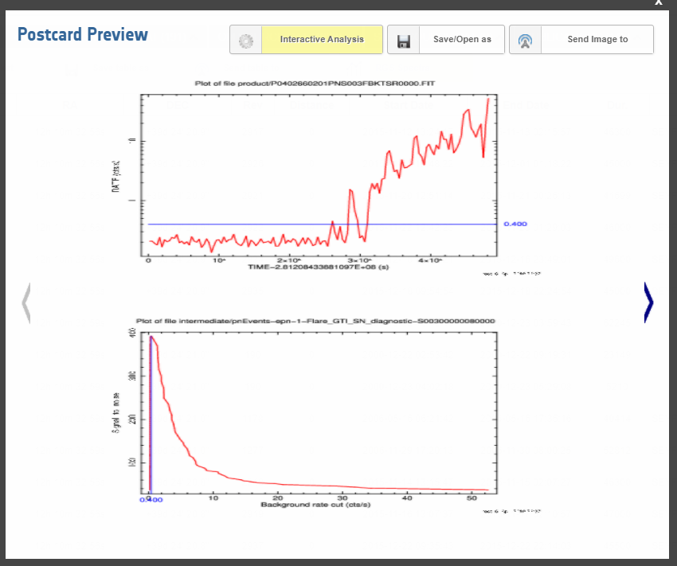

Slide 14
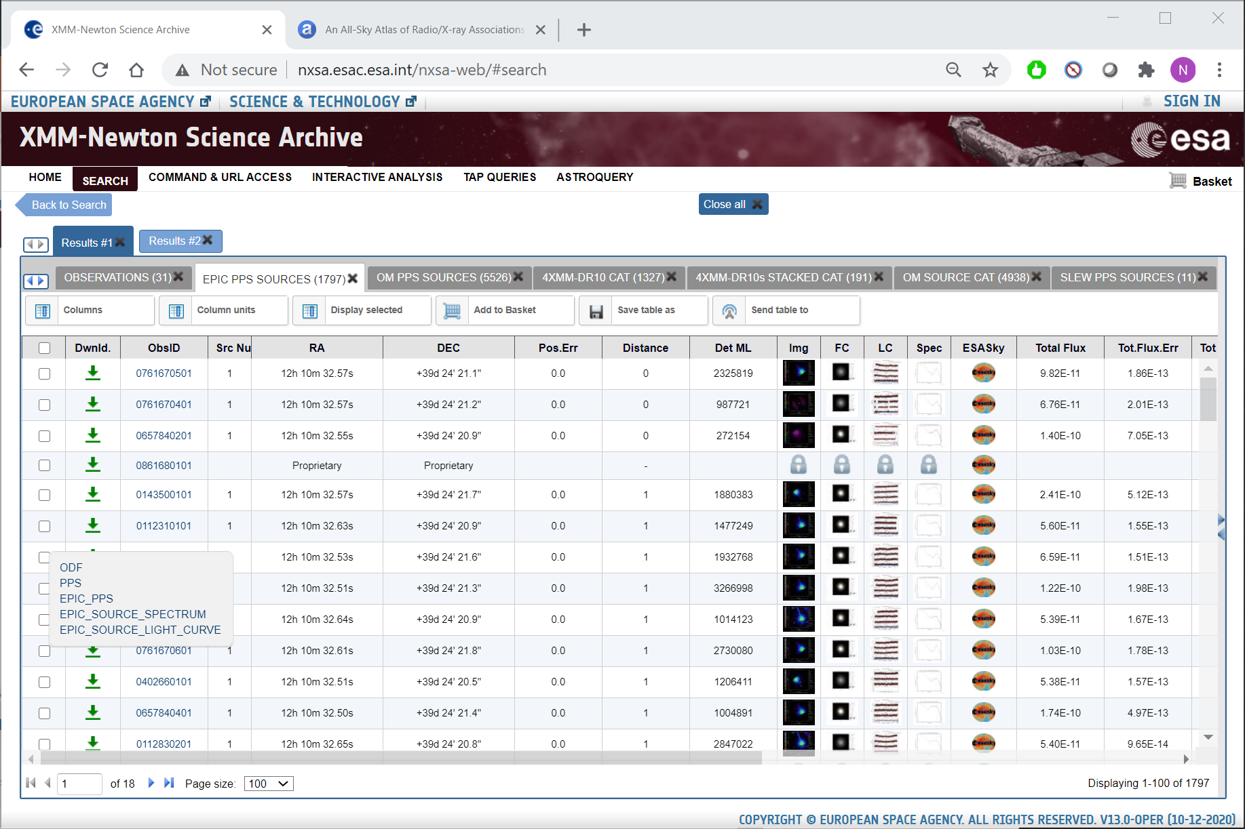
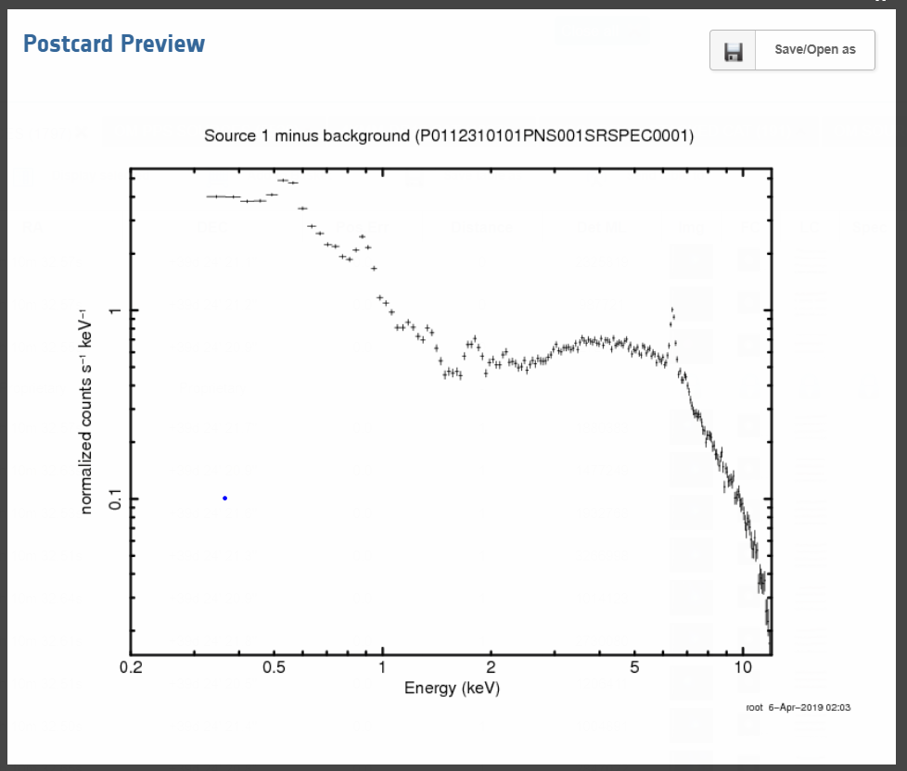
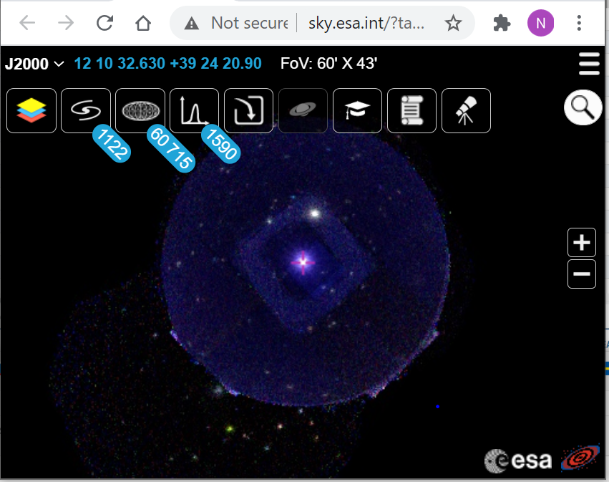
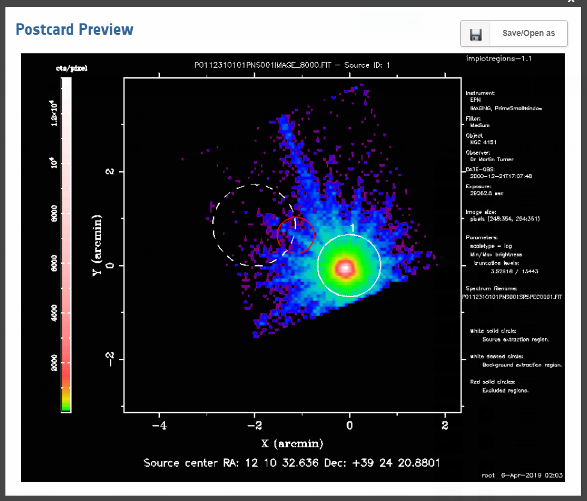

Slide 15
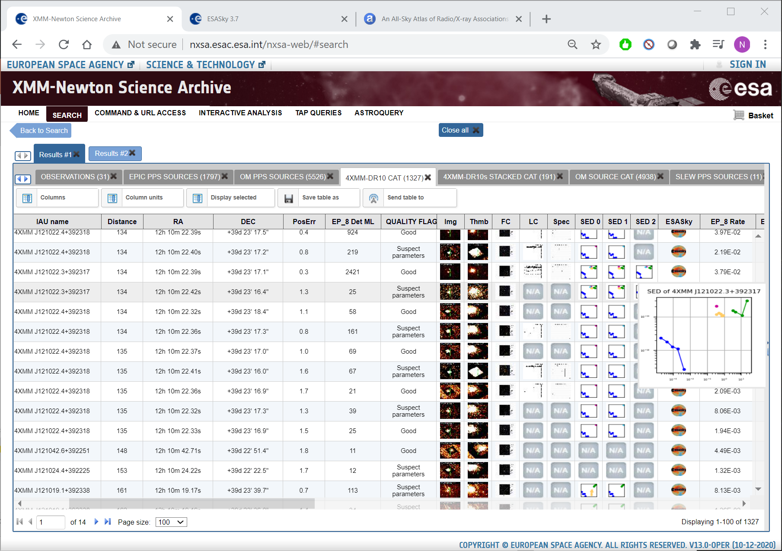
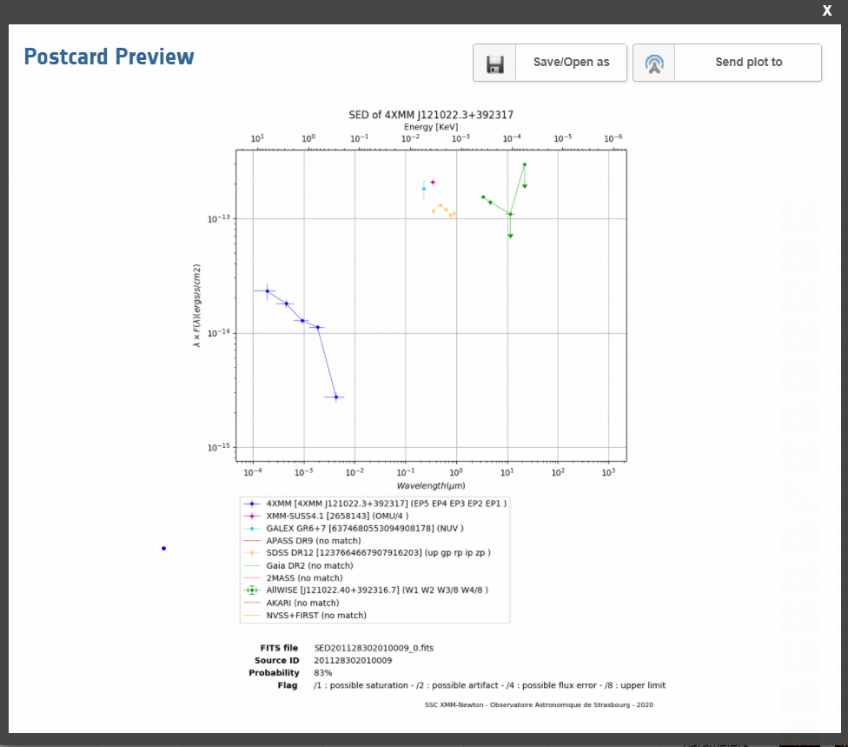

Slide 16
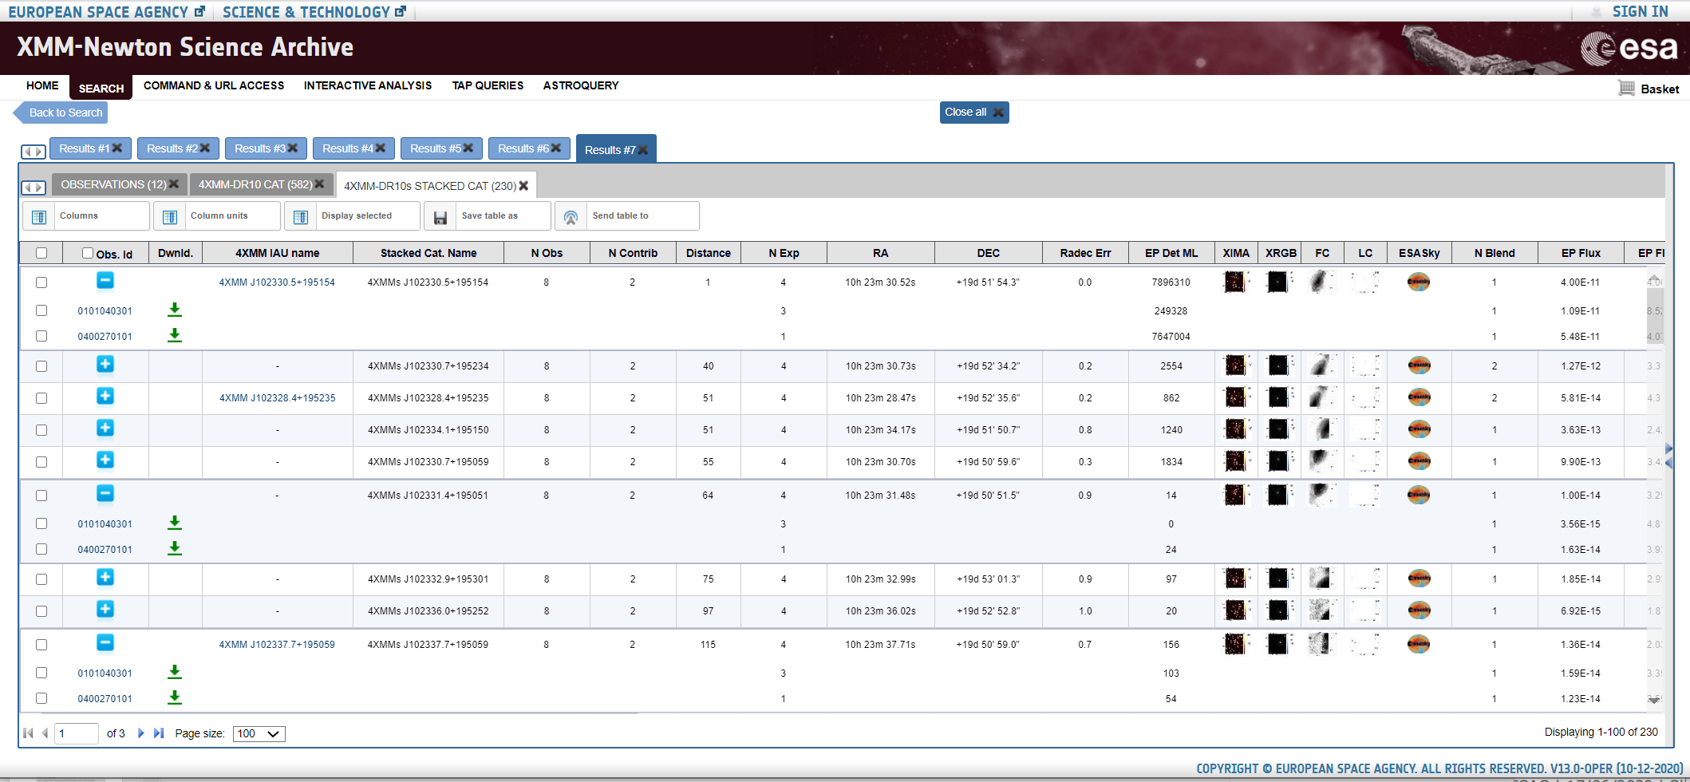
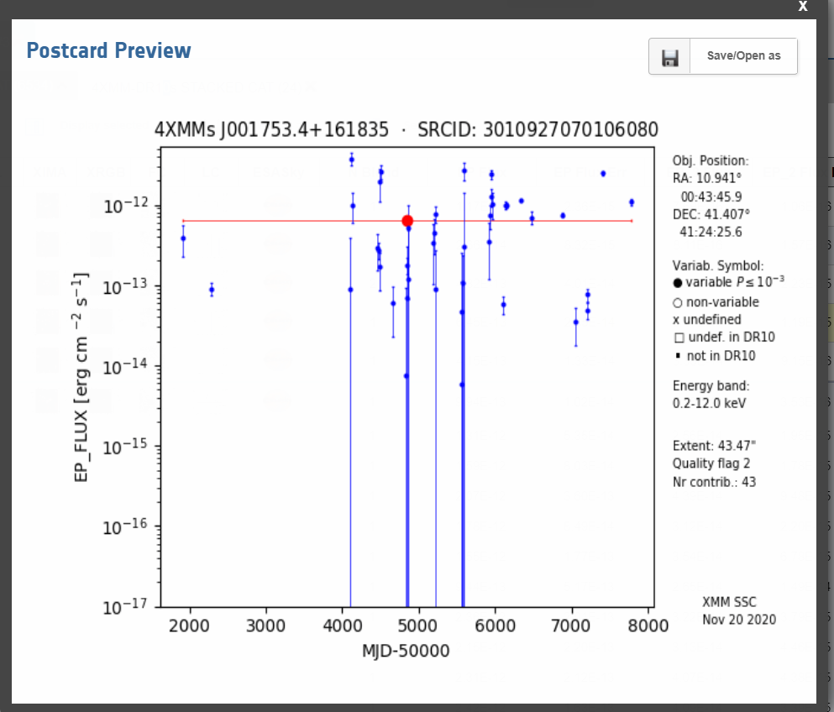
The EPIC Stacked Catalogue

Slide 17
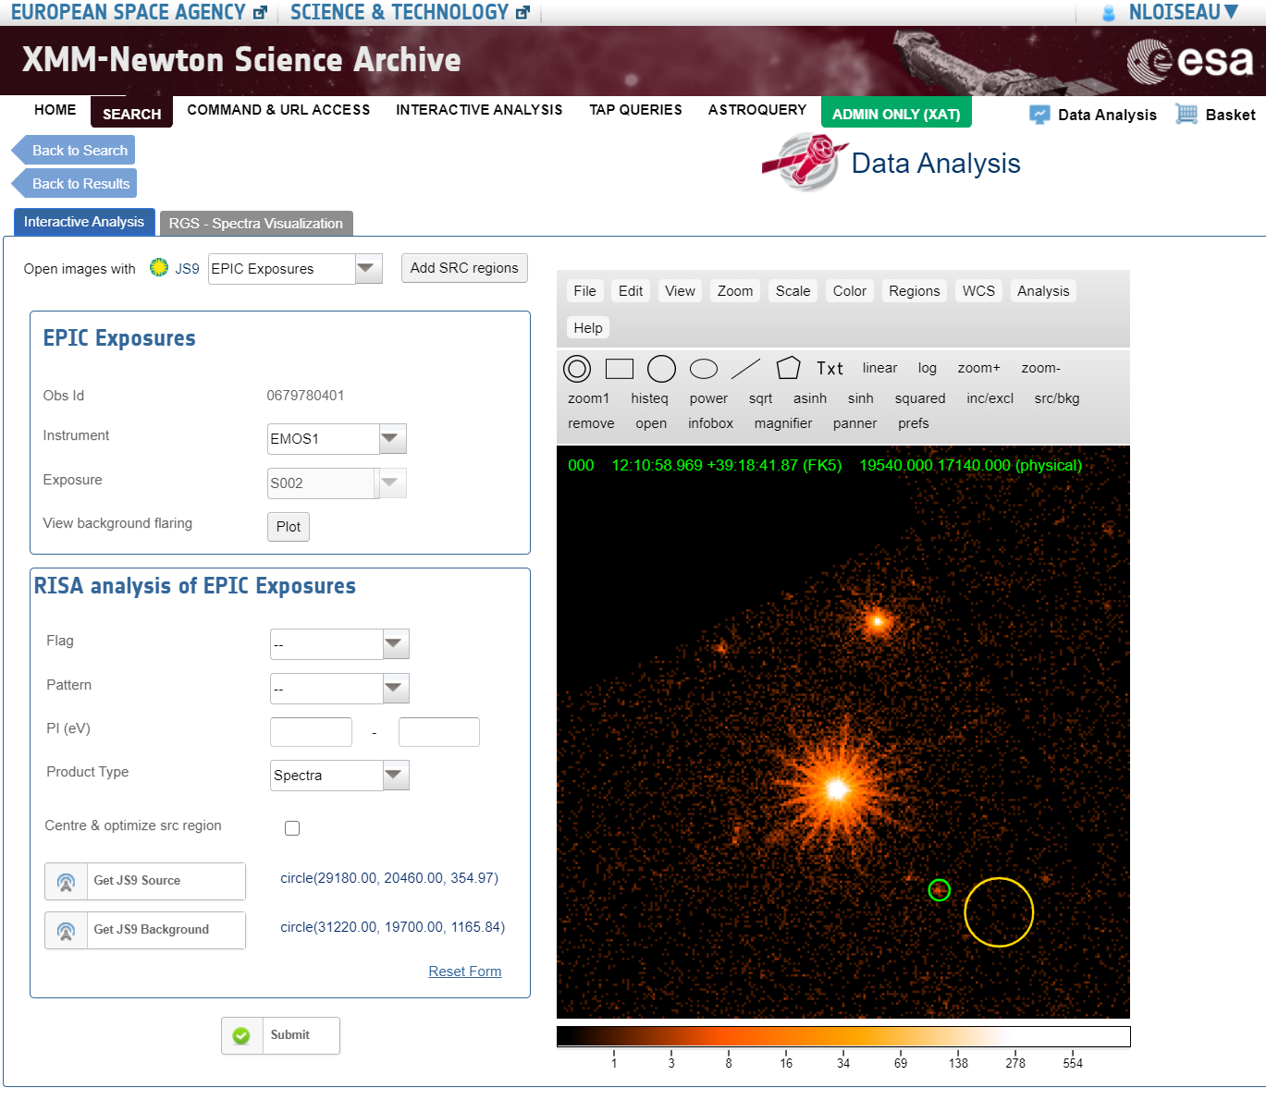
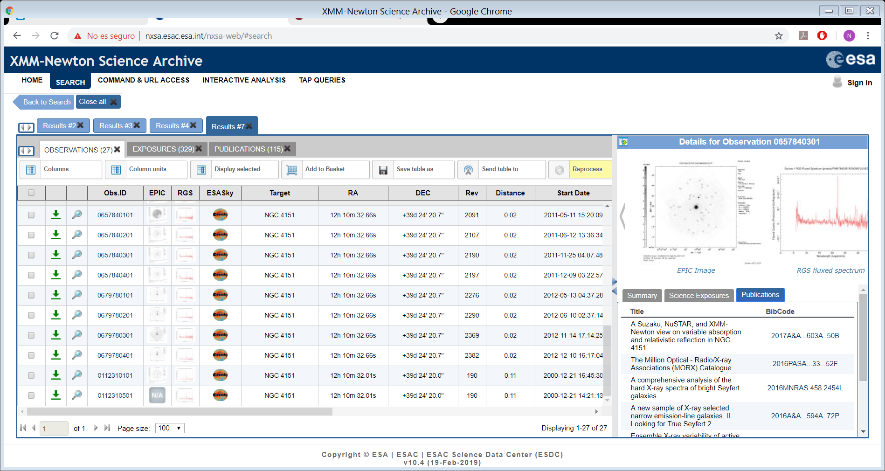
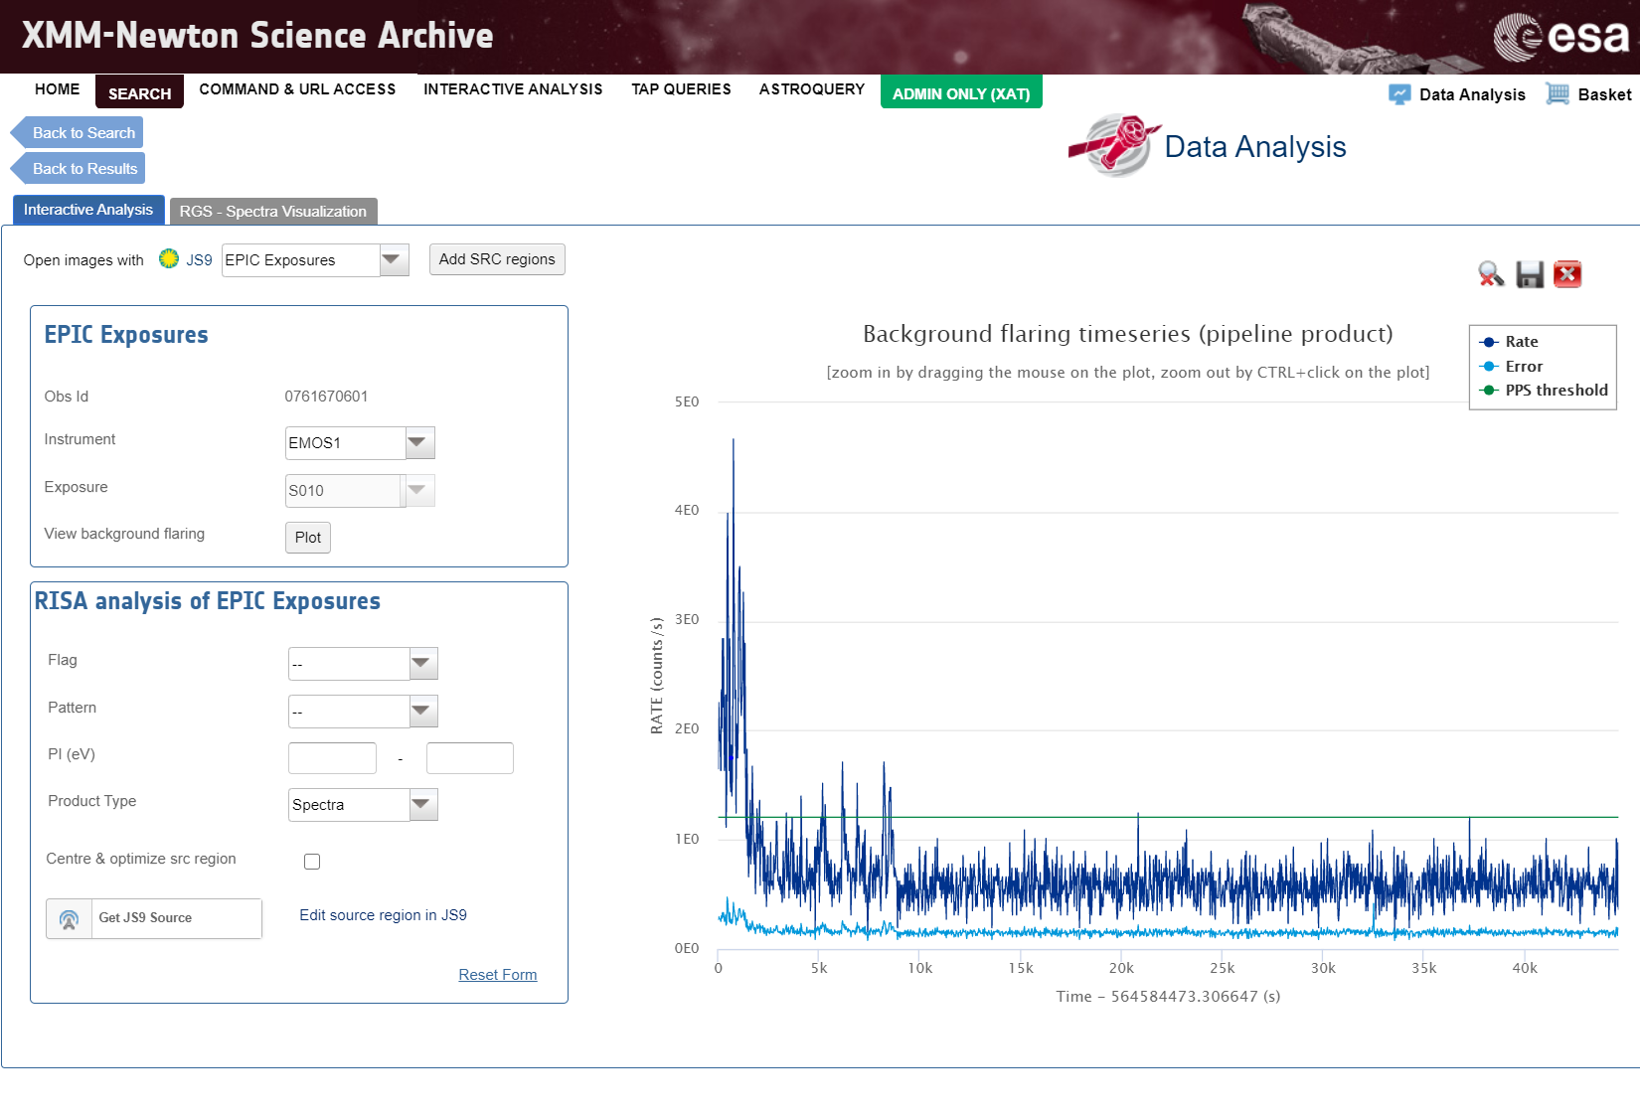
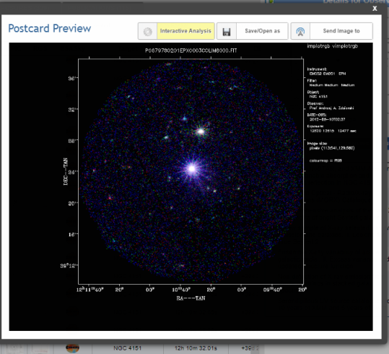
On-the-fly data analysis

Slide 18
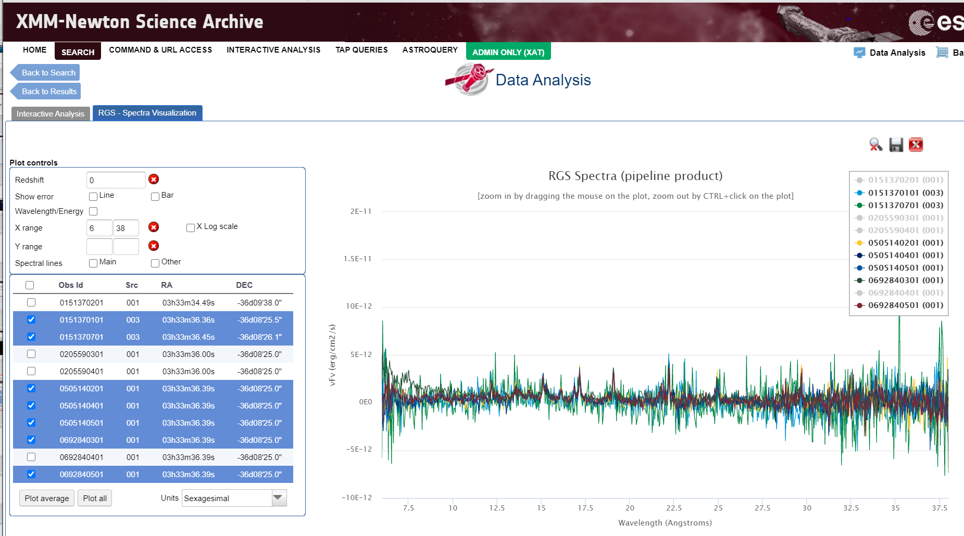
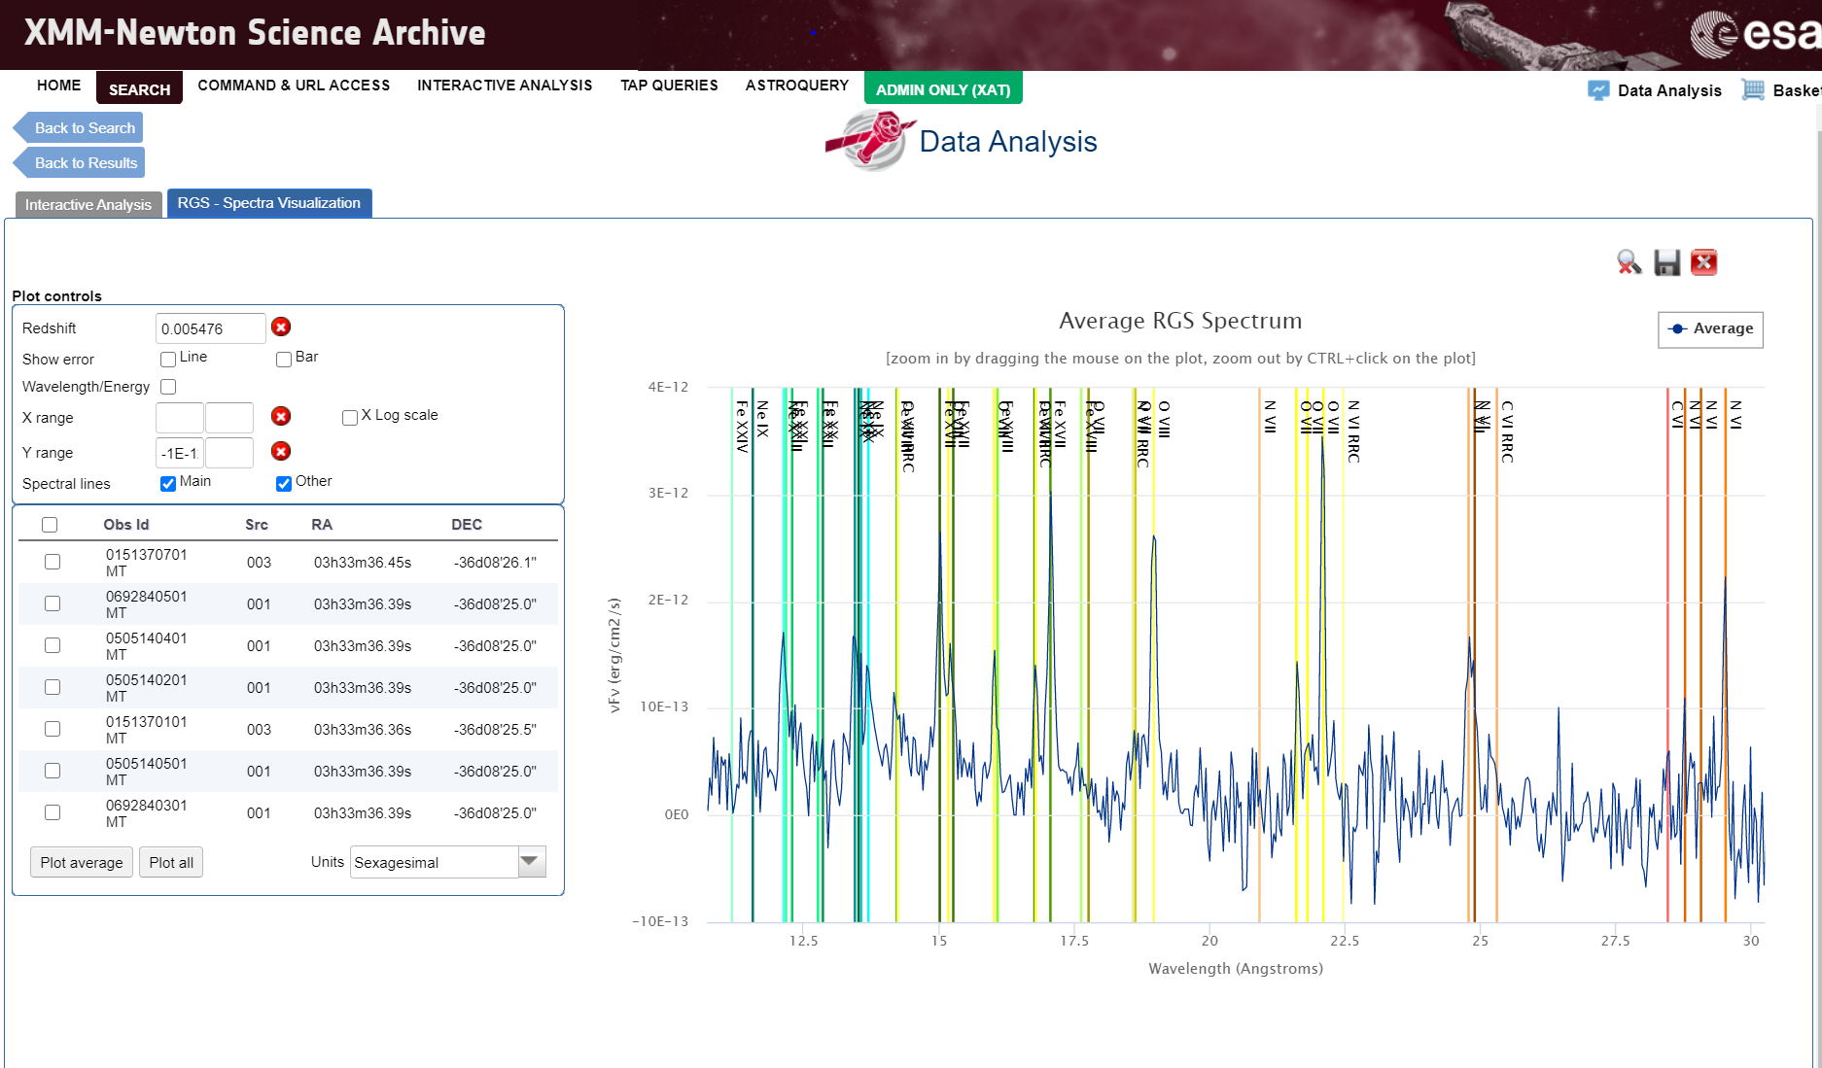
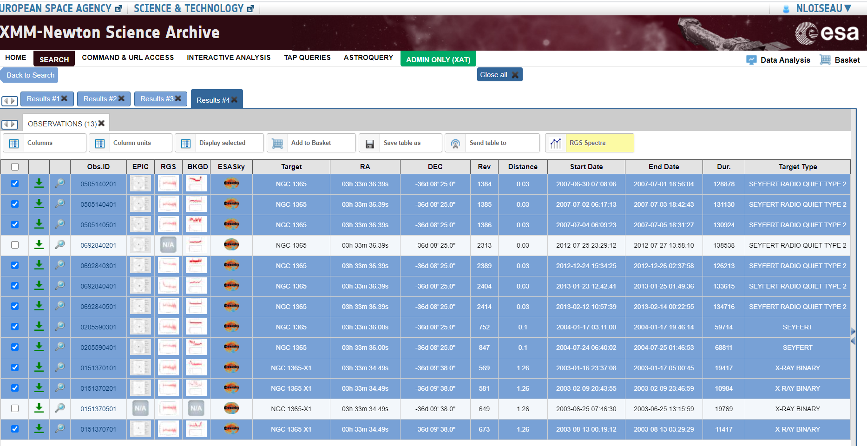
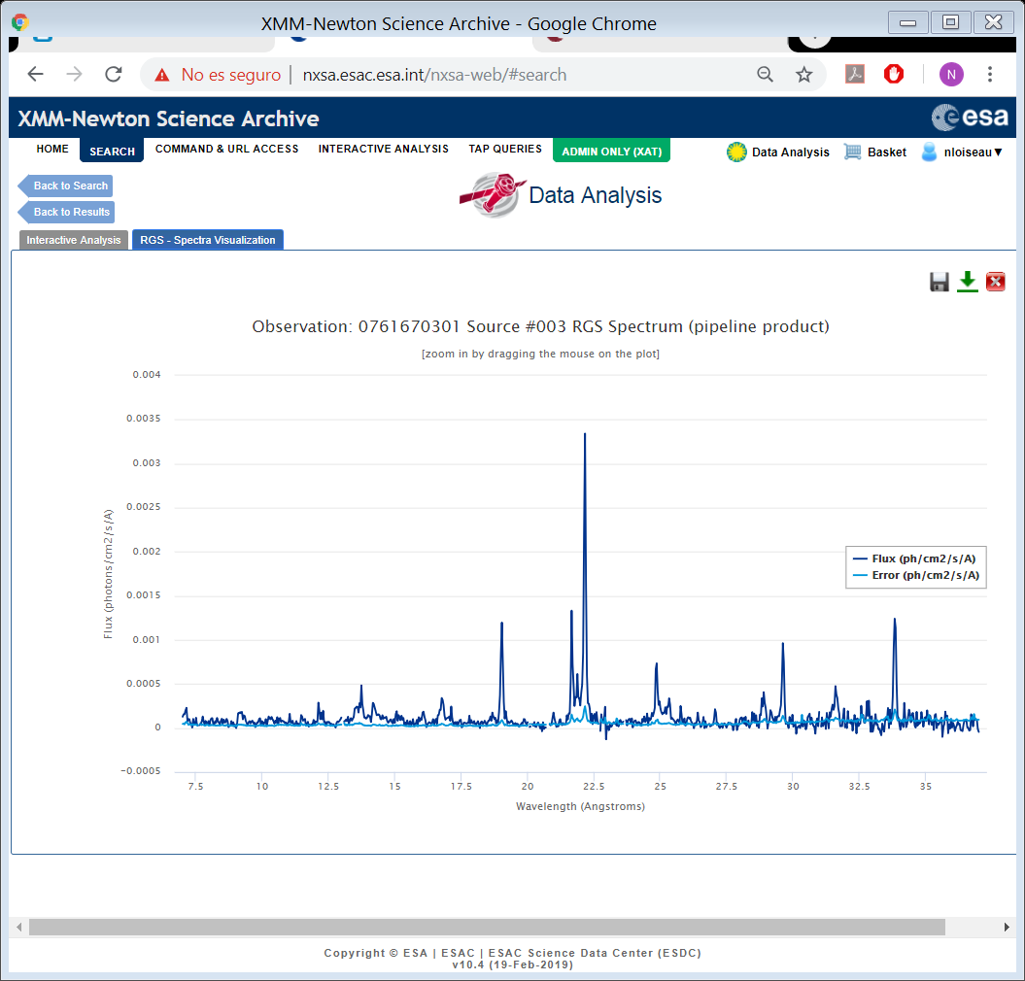
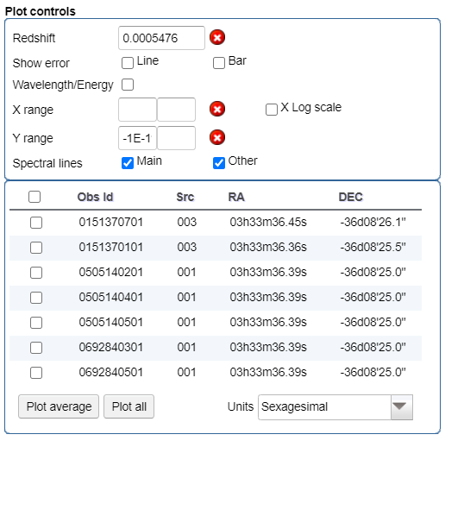

The RGS spectra viewer

Slide 19
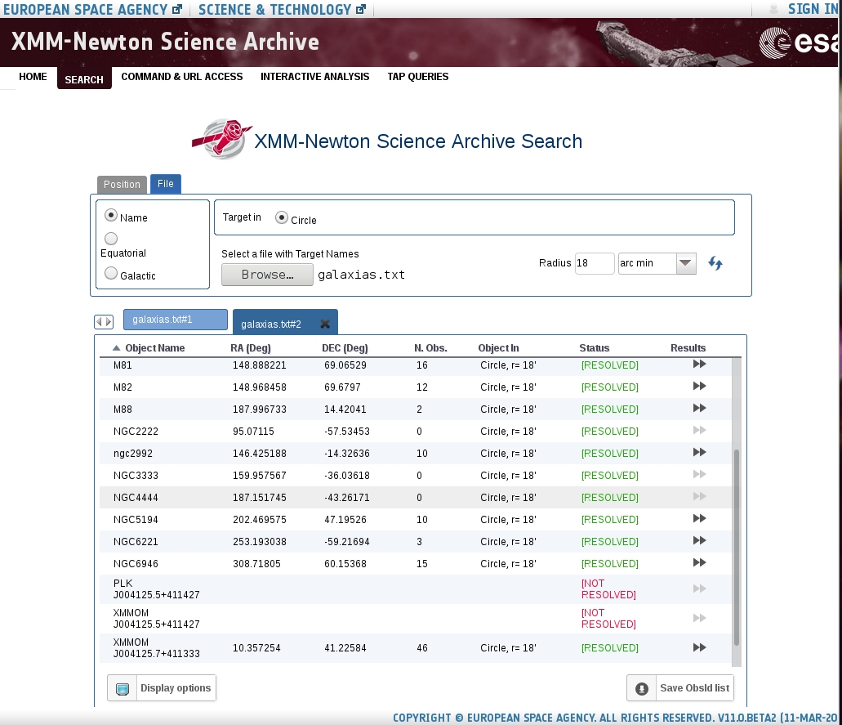
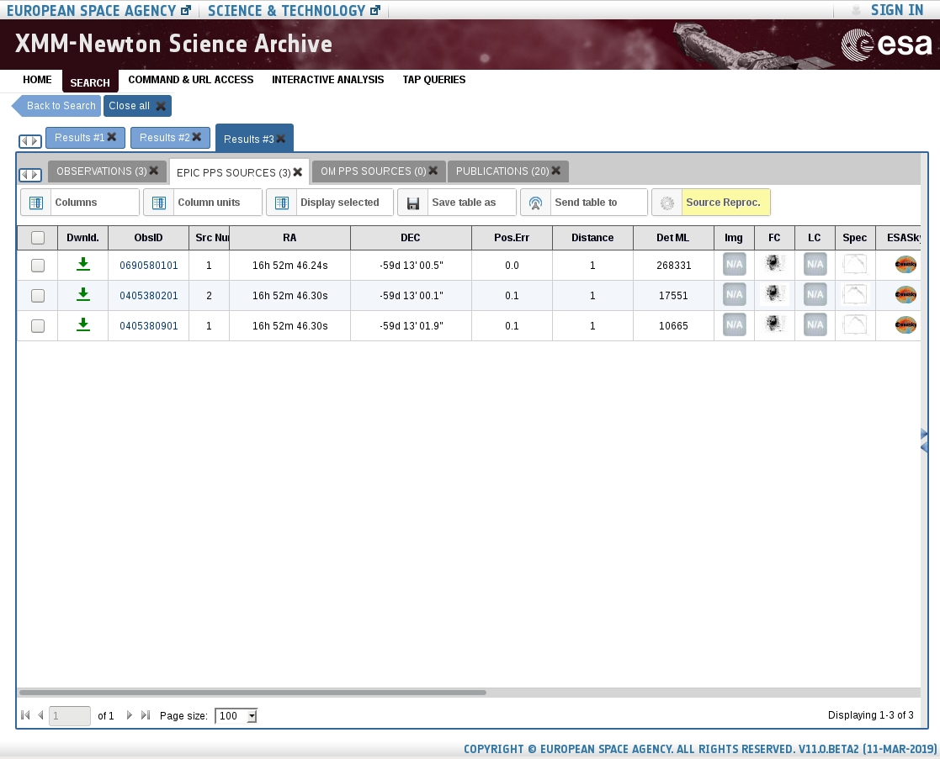
Search on a list of targets

Slide 20
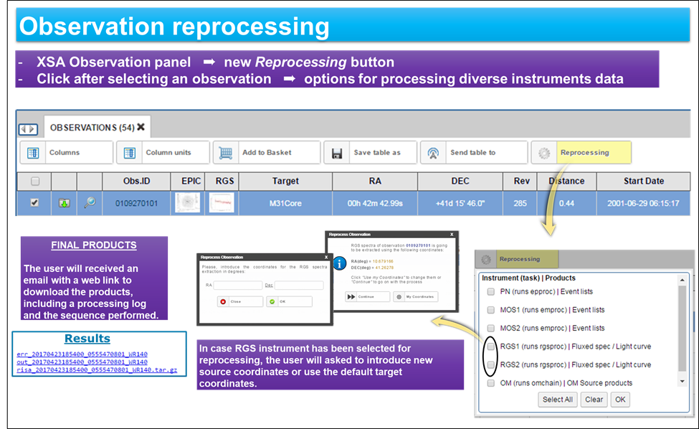
On-the-fly reprocess

Slide 21
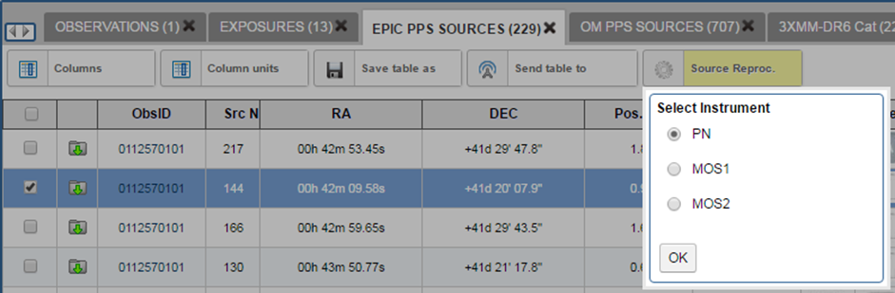
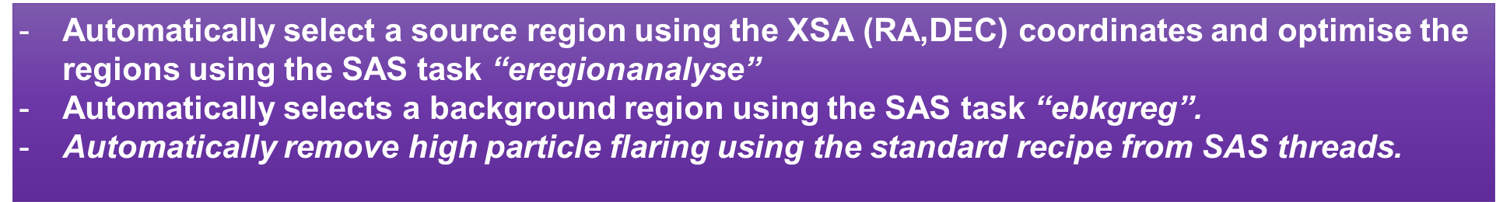
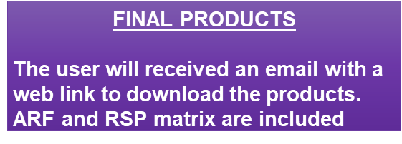
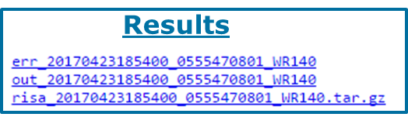

Slide 22
Direct Data Selection
and Download
Command line and URL access to the DB.
Direct queries to the XSA Database via Table Access Protocol (TAP) using ADQL language.
Astroquery

Slide 23
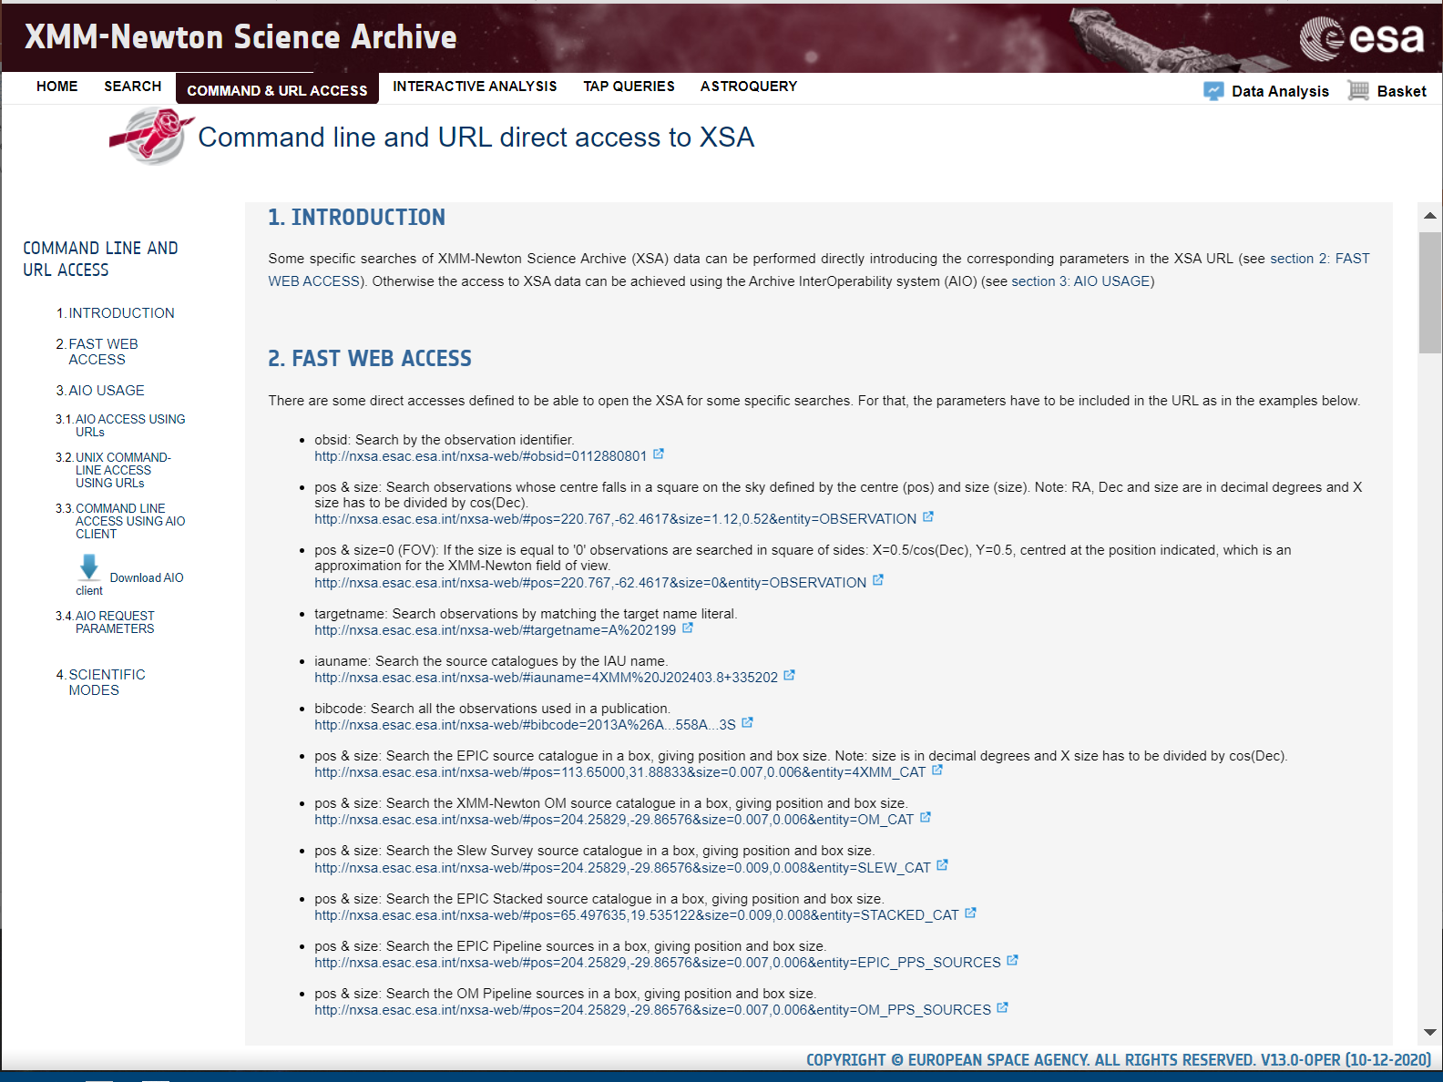
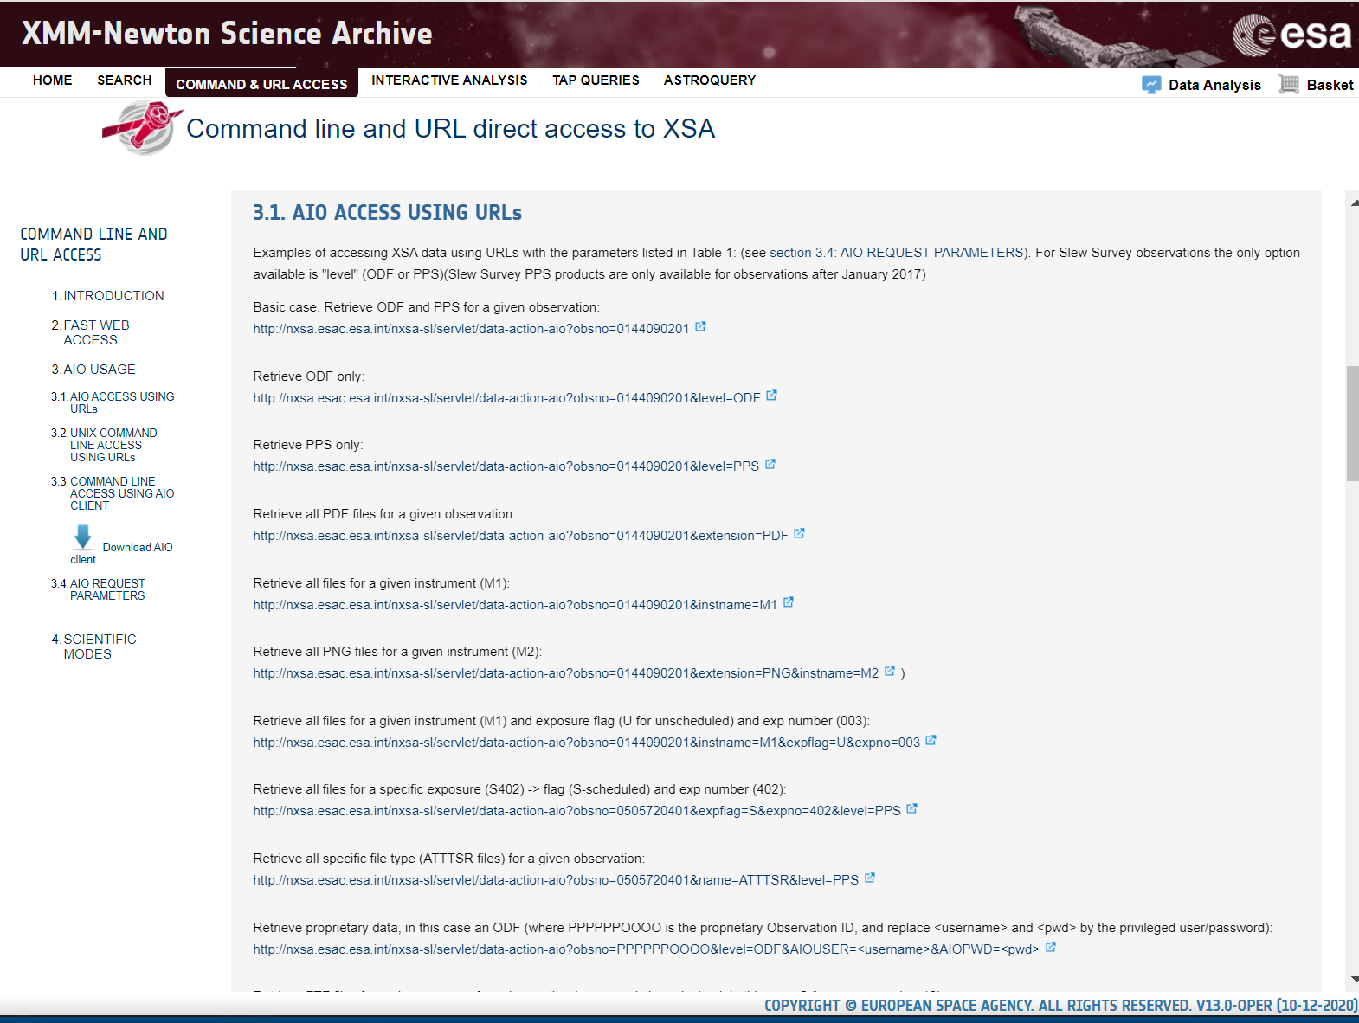
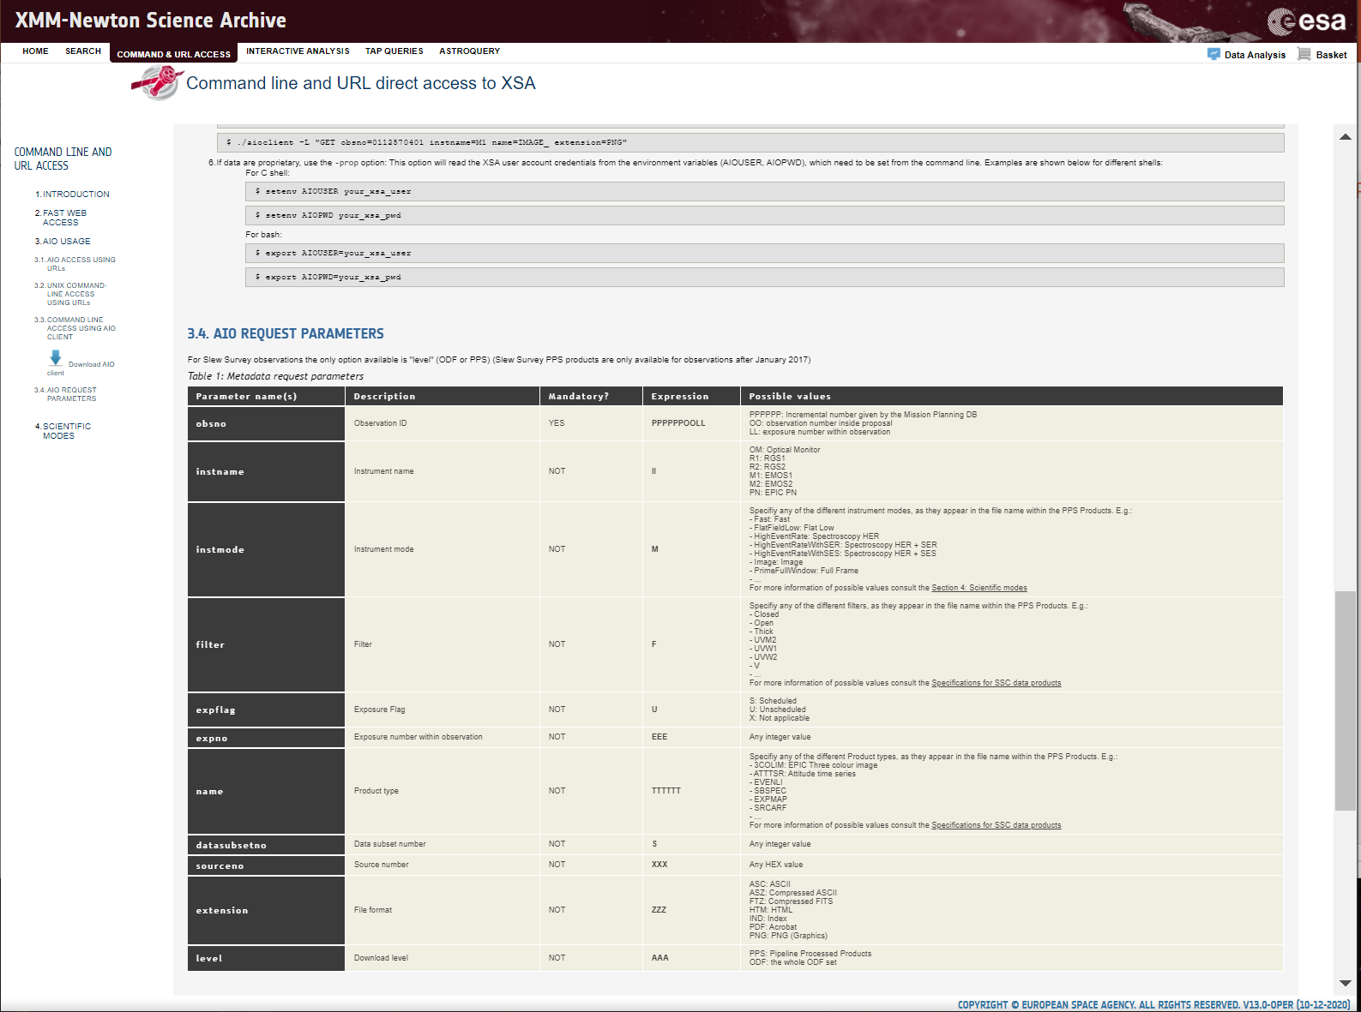
Direct data access: Command line & URL
http://nxsa.esac.esa.int/#aio

Slide 24
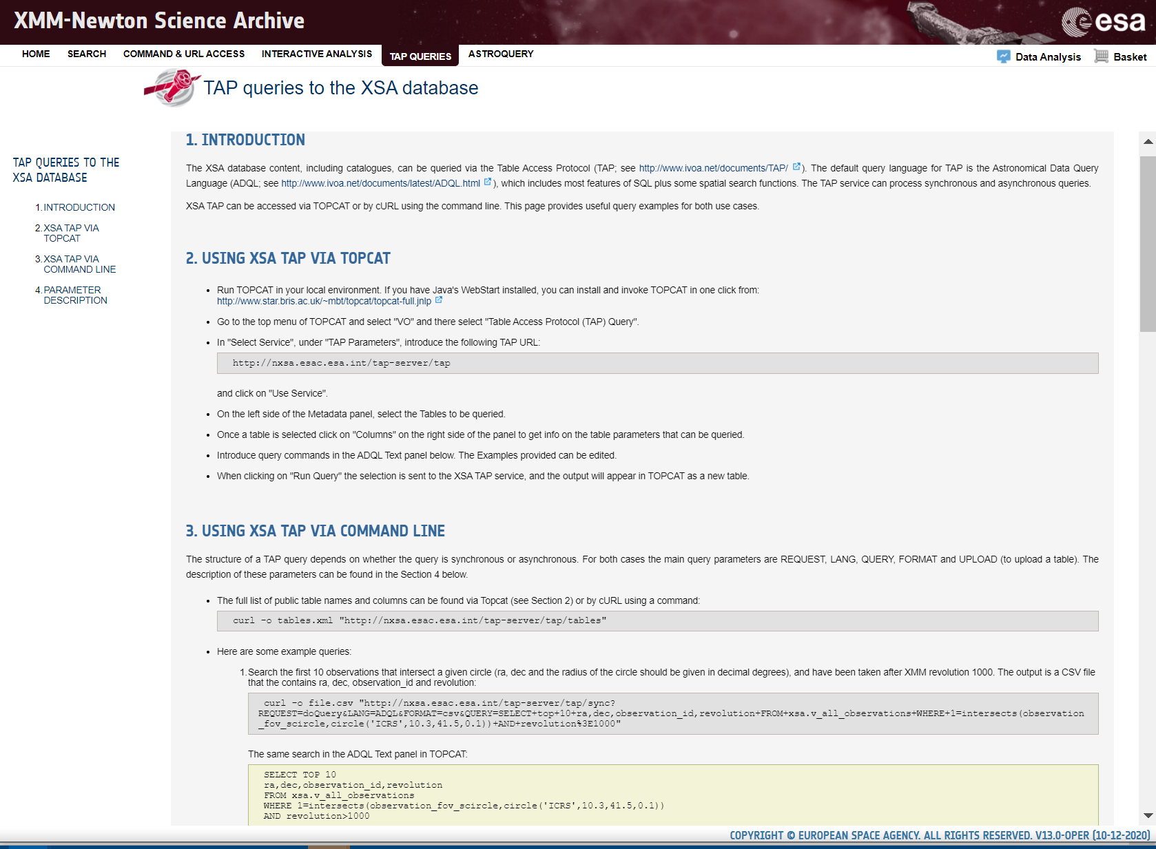
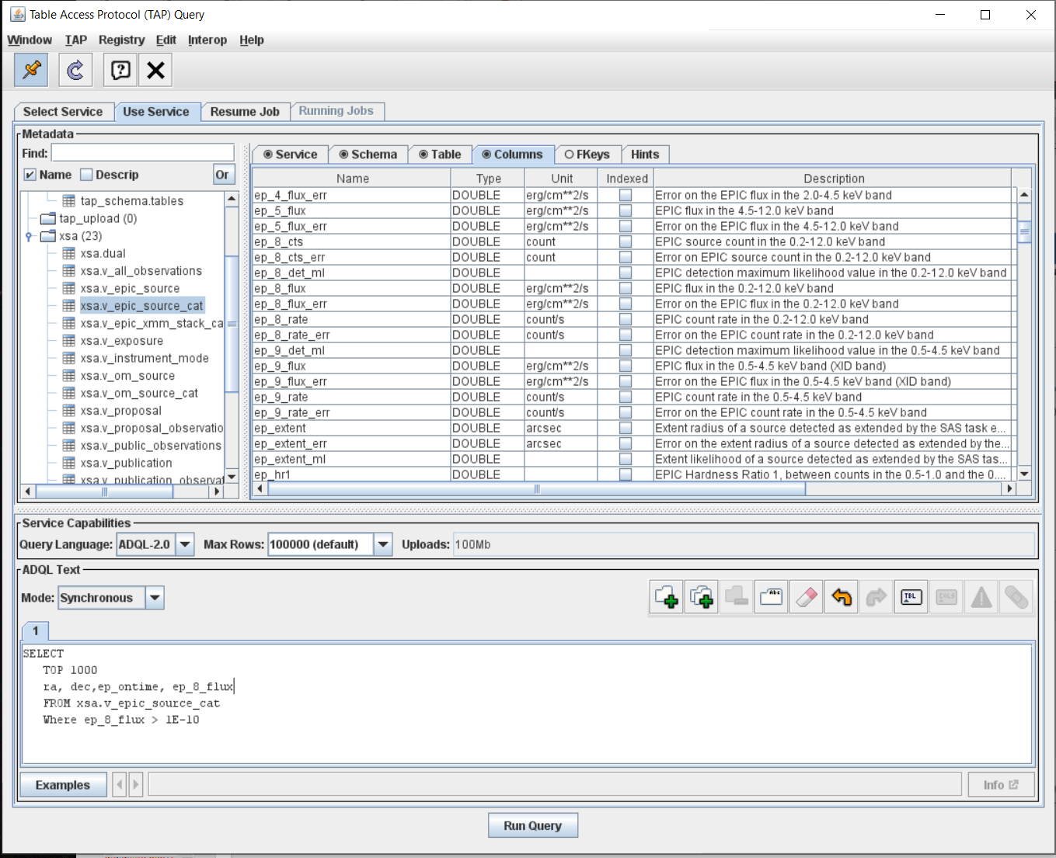
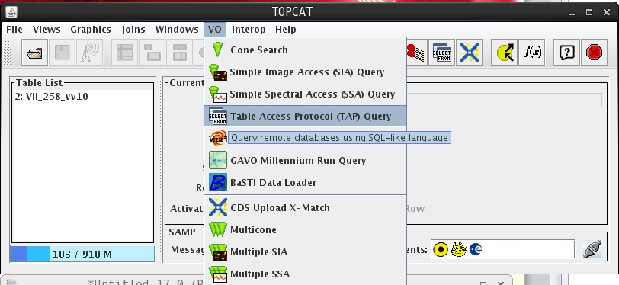
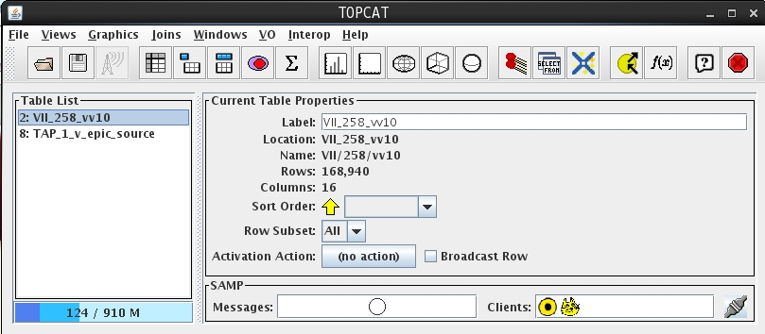
TAP queries to the XSA database via TOPCAT
http://nxsa.esac.esa.int/#tap

Slide 25
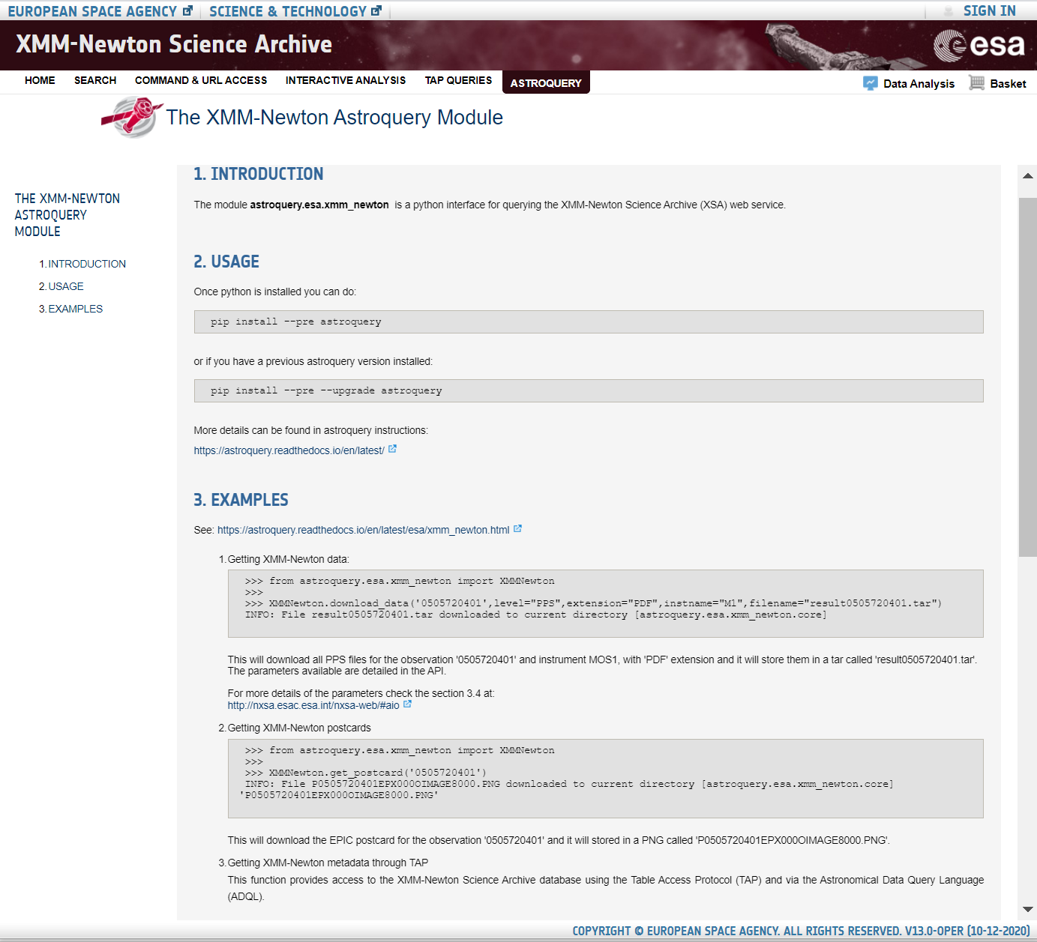
Query XSA using an Astroquery module
The specific Astroquery module for XMM-Newton, astroquery.esa.xmm_newton has been installed, and more functionalities are being added regularly
(see: http://nxsa.esac.esa.int/nxsa-web/#astroquery )
See examples also at:
https://astroquery.readthedocs.io/en/latest/esa/xmm_newton.html
Jupyter installation at:
https://jupyter.org/install

Slide 26



Other useful tools
XSA related Tools:
Upper Limit Tool
http://www.cosmos.esa.int/web/xmm-newton/uls
BiRD: Browsing interface for RGS Data
http://www.cosmos.esa.int/web/xmm-newton/bird
Slew Survey Latest Results
http://www.cosmos.esa.int/web/xmm-newton/latest-slew-results
Documents:
SAS Threads:
http://www.cosmos.esa.int/web/xmm-newton/sas-threads
SAS User Guide:
http://xmm-tools.cosmos.esa.int/external/xmm_user_support/documentation/sas_usg/USG
SAS Workshops:
http://www.cosmos.esa.int/web/xmm-newton/sas-workshops
Data Files Handbook
http://xmm-tools.cosmos.esa.int/external/xmm_user_support/documentation/dfhb/
Pipeline Products Description
https://xmm-tools.cosmos.esa.int/external/xmm_obs_info/odf/data/docs/XMM-SOC-GEN-ICD-0024.pdf
(search for “XSA archive XMM’’ in youtube!)

Slide 27
Q&A
Hands-on

